Slide 1




2024-25
Organization-wide Priorities, Outcome Goals & Infrastructure Requirements Translation

Slide 2


Our Journey to 2025
2024/25
2023/24
2022/23
I.
II.
Improve Experience,
Quality & Outcomes
for the People
We Serve
Improve Experience,
Health & Wellbeing
of all People at
Island Health
COVID
Strategic Framework
2025 Pillars
III.
IV.
Increase Value
& Ensure Sustainability
Improve
Population Health
& Wellness, Reduce Health Inequities
Notes:
Island Heath is on a journey to 2025 – guided by our 5-year Strategic Framework Pillars
This Framework helps create focus and organizational alignment; it moves us closer to our Vision of excellent health and care for everyone, everywhere, every time
As we all know and have experienced over the past few years, the road is not a straight line
Two years ago, the annual planning approach changed to make the achievement of outcomes the main success measure
It is ok to try different -- to let go of the ways we used to do things when they no longer make sense in our ever-changing world:
We need to be curious.
We need to step forward into new places.
We need to take some risk.
We need to believe there is a better way.
And in this approach, we learn each year, pulling forward what works and letting go of things that no longer work for us.

Slide 3

How did we do
in the 2023/24 cycle?
Notes:
Introduction to the look back at the stats…
In 2023/24, there were 62 measures across the 25 Outcome Goals
For most goals, there were multiple measures used to assess the achievement of the outcome goal, such as for Goal 7 (Increasing access to mental health and addiction treatment services) there were 6 measures tracked for 2023/24.
All measures are reported and monitored in an Organization-wide Priorities & Goals Dashboard.

Slide 4
2023/24
Measure Forecast
PRIORITY
PRIORITY
PRIORITY
PRIORITY
1
2
3
4
Address Indigenous
specific racism
Improve access to priority services
Pursue excellence in quality & safety
Create a culture of
safety & wellness
Pillar 1
Pillar 3
Pillar 2
Pillar 4
PRIORITY
PRIORITY
PRIORITY
PRIORITY
Achieve Target
5
6
7
8
Improved, Not Achieved
Not Yet Improved
Increase HHR capacity
& adapt to changing workforce
System redesign, innovation & operational excellence
Protect health
of population &
climate change
Promote population health &
prevent harm
*Data unavailable for 11 measures due to limitations in data capture
Notes:
Each of the segments within each of the circles represents a measure.
As noted on the slide, there are 11 measures where there were data capture limitations, and therefore are not currently included in the count within the dials on the screen.
The 26 darkest shaded segments refer to those measures where we achieved the targets. We set commitments for ourselves a year ago and we achieved 26 of those targets.
Discussion: How do these successes inform our work this fiscal year?
The next lighter shaded segments refer to where we improved in 19 measures but didn’t achieve the target.
Discussion: What have we learned from this experience and how are we bringing those learnings into this new fiscal year to ensure we fully achieve this year?
Discussion: Do we just need more cycles of time to fully meet our objective? Is there a slightly different intervention or change required for us to get this over the line?
The lightest shaded segments are where we have not yet improved.
Discussion: Do we have the right work to move the dials on the measures or do we need to think about different work?
Discussion: Do we have the right partners at the table to move through the challenge or do we need to think differently about who can help us work through the challenge?
All of these dials represent significant hard work across portfolios and programs working together to get to full achievement of targets. It is with gratitude that we recognize the commitment and efforts made by everyone involved.

Slide 5
2023/24
Measure Forecast
26 of 51 measures achieved
50%
Achieve Target
*Data unavailable for 11 of 62 measures due to limitations in data capture (hence 51 measures shown above)
Improved, Not Achieved
Not Yet Improved
Notes:
This past year we achieved 50% of the targets we set for ourselves, and we improved against an additional 37% of the targets set.
Data unavailable for 11 of 62 measures due to limitations in data capture (hence 51 measures shown above)

Slide 6
Infrastructure requirements
INF
Achieve Target
Improved, Not Achieved
Notes:
Infrastructure requirements are like launch pads:
You need strong foundations in place to launch rockets – to launch our work against our outcome goals – which will take us forward, accelerate us towards our Vision.
This past year, we fully met the expectations we set for ourselves in 6 of the 9 infrastructure requirements.
Clinical Governance is a good example of an infrastructure requirement this past fiscal year, and one where we met the expectations last year.
We have Island-wide Care Networks in place, and we are now building local care networks.
These are foundational for us to advance and accelerate our quality work.
Infrastructure requirements that were completed allow us to now get to results of the outcome goals we’ve set for 2024-25.
We’ve identified new infrastructure requirements for this year that will again position us for getting to results in subsequent years.

Slide 7

Transitioning to 2024/25
Notes:
Reflecting on our work last year and where we are today, we are humble enough to know today we are not yet where we need to be in achieving outcomes
We hear from our patients and clients and their families . . . we hear it from our partners and our communities.
We are doing good work, AND there is much more that needs to be done to meet people’s needs today and better position us to meet the needs of tomorrow.
There is much more that needs to be done to advance us along our Roadmap to our Vision of excellent health and care for everyone, everywhere, every time.

Slide 8

VISION
Excellent Health and Care for Everyone, Everywhere, Every Time
STRATEGIC FRAMEWORK PILLARS – 3-5 Year Aims & Select Markers of Progress
I. | Improve Experience, Quality & Outcomes for the People We Serve | II. | Improve Experience, Health & Wellbeing of all People at Island Health | III. | Increase Value & Ensure Sustainability | IV. | Improve Population Health & Wellness, Reduce Health Inequities
◆ PATIENTS HIGHLY RECOMMEND ISLAND HEALTH 
◆ NATIONAL LEADERS IN QUALITY & SAFETY 
◆ STAFF HIGHLY RECOMMEND ISLAND HEALTH 
◆ RANKED TOP EMPLOYER 
◆ ↑ % COMMUNITY SERVICES EXPENDITURES RELATIVE TO ACUTE  CHOOSING WISELY CHAMPION 
◆ ↓GAPS IN HEALTH STATUS FOR INDIGENOUS PPL  ↑ POPULATION HEALTH EXPENDITURE AS % OF TOTAL  CLIMATE CHAMPION 
Unresolved Indigenous- Specific Racism & Bias
Unmet Access Needs
Avoidable Variation & Harm
TOP ENTERPRISE RISK THEMES
Lack of Workforce Capacity & Wellness
Lack of change capacity & agility
Disparity in Population
Health & Health Inequities
Commitment to Demonstrating Cultural Humility in Our Ways of Being
2024/25 ORGANIZATION-WIDE PRIORITIES, OUTCOME GOALS, & INFRASTRUCTURE REQUIREMENTS
PRIORITY 1
Address Indigenous-
Specific Racism
PRIORITY 2
Improve Access to
Priority Services
PRIORITY 3
Pursue Excellence
in Quality & Safety
PRIORITY 4
Create a Culture of
Safety & Wellness
PRIORITY 5
Increase Health Human Resource Capacity & Adapt to Changing Workforce Needs
PRIORITY 6
Increase Sustainability through System Redesign, Innovation
& Operational Excellence
PRIORITY 7
Protect the Health of the Population & Take Action on Climate Change
PRIORITY 8
Promote Population
Health & Prevent Harm
2024-25 Priorities
G1. ↑ Speak Up Culture Where Staff Understand How, & Feel Safe, to Report Racism They Witness or Experience G2. ↑ Representation of Indigenous People in Leadership Roles Across All Portfolios in Island Health | G3. ↑ Access Same Day Island Health Primary Care G4. ↑ Access to Priority Surgery & ↓ Long Wait-times G5. ↑ Access to Diagnostics &  Site-Based Targets for MRI and CT Wait-Times G6. ↑ Timely & Appropriate Access to LTC G7. ↑ Access to MHSU Treatment & Services (↓ Urgent Mental Health Assessment, ↓ Detox Wait-Times, ↑ Community Counselling Clients) G8. ↑ Acute Sites in Collaboration with Local Indigenous Communities & Partners have Partnership Tables to Strengthen Relationships & Address Concerns | G9. ↑ Key Practice Standards (Candidates) Best Possible Medication History (BPMH) & Medication Reconciliation Advance Care Planning & MOST Pre-hospital Functional Assessment on Admission Delirium Detection & Prevention G10.  Key Performance Targets (Candidates) Appropriate Use of Antipsychotics Patient Safety Events With Completed Reviews G11. ↑ Patient Experience Using Relationally-Focused & Accountable Approaches to Prevent Harm & Promote Healing | G12. ↑ Employees & Medical Staff Report Leadership Cares About Their Safety & Well-being, Inclusive of Medical & Indigenous Staff G13. ↓ Workplace Injury | G14. ↑ Workforce Capacity (↑ Medical Staff Recruited, ↑ New Types of Roles, & ↑ Total Worked Hours) G15. ↑ Staff & Medical Staff Engagement with ↑ Staff Report Open & Honest Communications, ↑ Recognition for Good Work | G16. ↑ Community Care Services, including Access to LTC from Community, to ↓ Need for Hospital Utilization G17. ↑ Effective, Responsive Hospital Care & ↓ Wait-Time for Inpatient Bed at Each Site G18. ↑ Navigation to Community-Based Services for Complex Frail Elderly & MHSU Clients G19. A ↑ Virtual Care Services (↑ Community Virtual Care Clients & ↑ Regional Services), B ↑ Patient Engagement & Activation (↑ Portal Enrollment, ↑ Notes Released, ↑ Notes Viewed) G20. ↑ Innovations in Each Phase of the Innovation Life Cycle to ↑ Staff Engaging in Innovation & ↑ Priorities Addressed by Innovation | G21. ↑ Access to All Publicly-funded Vaccinations ( Targets for 7-year-old Vaccinations, Grade 10 HPV, Time to Next Appointment) G22.  Island Health’s GHG Emission Target & ↑ Waste Diversion to Mitigate Climate Impact G23. ↑ Community Preparedness & Resiliency for Climate Emergencies | G24. ↑ Access to Appropriate Care for People Who Use Substances G25. ↑ Healthy School Programming to ↑ Youth Mental Health Resiliency
I1 Introduce Cultural Safety & Humility Standard, I2A Implement Indigenous Self-Identifier & I2B Establish Governance and Data Analytics Framework, I3 Optimize Clinical Governance Model & Advance Clinical Services Plan, I4 Advance EHR & Implement CPOE at Tertiary Sites, I5 Establish System of Health & Care for Addictions, I6 Implement Year 1 of the Human Experience Strategy | I7 Advance Human Resource Information Systems, I8 Advance Medical Leadership Strategy | I9 Accelerate Digital Strategy, I10 Advance CDH Replacement Project, I11 Advance Design & Procurement for New LTC Homes, I12 Modernize Community Care Information Systems | I13 Advance Healthy Public Policy on Alcohol Use
ENDURING PERFORMANCE MEASURES BY DIMENSION OF QUALITY (PERFORMANCE DASHBOARD)
RESPECT | SAFETY | ACCESSIBILTY | APPROPRIATENESS | EFFICIENCY & EFFECTIVENESS | EQUITY
Patient Concerns Completed Same-Day Surgical Cancellation* Home Support Visits Cancelled by HA* | Hospital Standardized Mortality Clostridium Difficile Disease Hospital Harm – Overall* Pt Safety Events w Completed Reviews* Sick Time* Days Lost* Time Loss Claims Rate* Long Term Disability* Drinking Water Quality | Left Emergency Without Being Seen* Long Term Care Wait Time* Surgeries Waiting Longer Than Benchmark* MRI Meeting Benchmark* CT Meeting Benchmark* Home Care Professional Services Meeting Benchmark* | Potential Inappropriate Use of Antipsychotics in LTC* Worsening Pressure Ulcers in LTC ED Wait Time for Inpatient Bed* Length of Stay v. Expected Length of Stay in Acute Care* Alternative Level of Care* Ambulatory Care Sensitive Conditions Hospitalizations (75+) * | Overtime* Employee Turnover* Working Capital Ratio Equipment Investment Index Facility Condition Index Greenhouse Gas Emissions* 7 Year Childhood Immunization Coverage* | Toxic Drug Deaths* Self Harm Hospitalizations* Hospitalizations Entirely Caused by Alcohol* Life Expectancy Disparity Ratio Age-Standardized Rate of Diabetes* Infant Mortality
* Enduring measures directly
supported by the 2024/25 Goals
Draft as of 2-Apr-2024
Notes:
These are the 2024-25 Priorities, Outcome Goals and Infrastructure Requirements – they are here to provide a common direction for Island Health, that provides hope, clarity, and purpose, and defines the work we need to do to improve conditions for tomorrow, not a distant future.
80% of what you see on this page has been pulled through from 2023-24.
This is because we have more improvements to achieve within our existing 8 priorities and 25 outcome goals established last year.
Outcome goal targets are established on an annual basis, and we are making incremental advancements to get us to where we need to be.
The outcome goals and infrastructure requirements also reflect provincial government direction received through the mandate letter. We’ve integrated this direction within the measures and targets established this year and the change work we will focus on to get us to results.

Slide 9
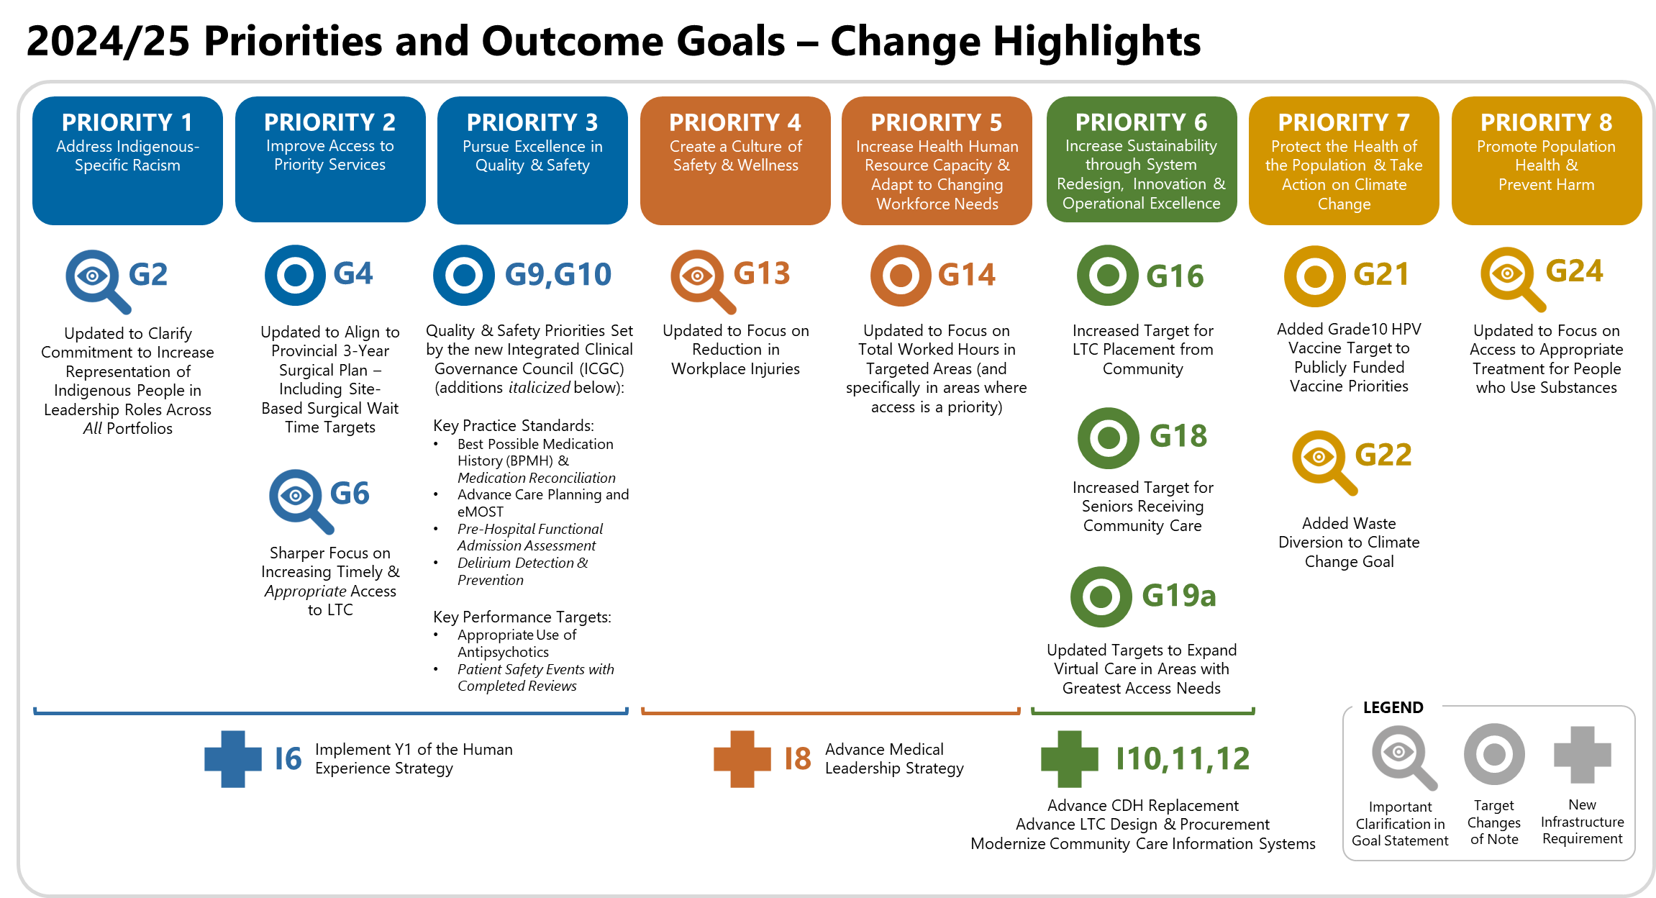
2024-25 Priorities
Notes:
While 80% of the 2024-25 goals and infrastructure requirements have pulled forward from last year, there are some shifts to note, reflecting our learnings and experiences. There are important clarifications in some goal statements, target changes of note and some new infrastructure requirements. All of this allows us to refine and focus our efforts and resources to getting to results this year.
Priority One – Goal 2 changed to clarify the importance of increasing the representation of Indigenous people in leadership roles across all portfolios
Priority Two – Ministry Objective & Key Result (OKR) metrics incorporated into all Goals, though most notably in Goal 4 (Surgery); the changes to Goal 6 are part of the way Island Health is looking at the full continuum of care between acute, community, and LTC that will show up again the changes to Priority 6
Priority Three – the new Integrated Clinical Governance Council and CARE Networks identified quality and safety priorities for Island Health, as seen in Goals 9 (Key Practice Standards) and 10 (Key Performance Targets) – clinical goals identified by clinicians
Pillar One Infrastructure – adds the first year of the Human Experience Strategy, which including the experience of both patients and families, and all staff, at Island Health
Priority Four – there is a very specific target on decreasing injuries, and leaders’ roles in focusing on the safety of their teams
Priority Five – Goal 14 improved the focus of the measures by moving away from Shift Fill Rate (which was too broad at the organizational level) to Total Worked Hours in targeted areas
Pillar Two Infrastructure – adds the advancement of a Medical Leadership Strategy that is designed to bring the medical leadership structure into line with recent years’ organizational changes, with accompanying supports
Priority Six – Goals 16, 18, and 19a are all increasingly focused on how acute care, community care, and long-term care, supported by virtual care, are part of the larger continuum of care that connects them all, and incorporate both Ministry OKRs and changes designed to redesign the system for the future
Pillar Three Infrastructure – adds in capital projects that will require organizational attention in the coming year (CDH replacement, three LTC facilities), as well as the modernization of community care information systems
Priority Seven – Goal 21 adds the HPV vaccine to the publicly-funded immunizations focused; Goal 22 adds waste diversion in Island Health facilities, and further contributes to Island Health’s commitment to lessening its climate impact
Priority Eight – Goal 24 changes the focus from drug poisoning deaths to the provision of appropriate treatment to people who use substances

Slide 10
Share the 2024-25 annual priorities with your teams, within the next 30 days, to build a common sense of purpose.
Create individual goals within 60-90 days.
Expectations
Notes:
Meet with your teams to translate the annual priorities by the second week of May
Reflection: How will I translate this information for my team?
Reflection: Where do I anticipate any challenges?
Meet with your team members ideally before the end of May to develop individual goals for 2024-25.
Individual goals are added to the My Performance Navigator tool and aligned to the Organization-wide Priorities
Goals can be entered for this performance year any time after April 1, and ideally before the end of May 2024.

Slide 11
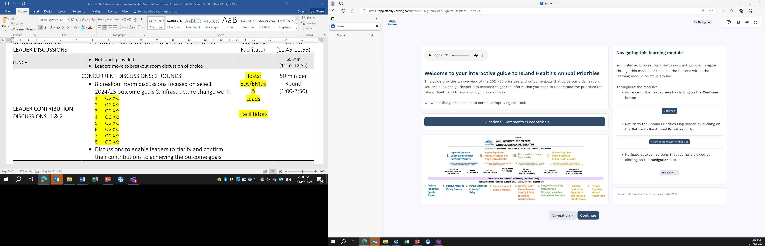
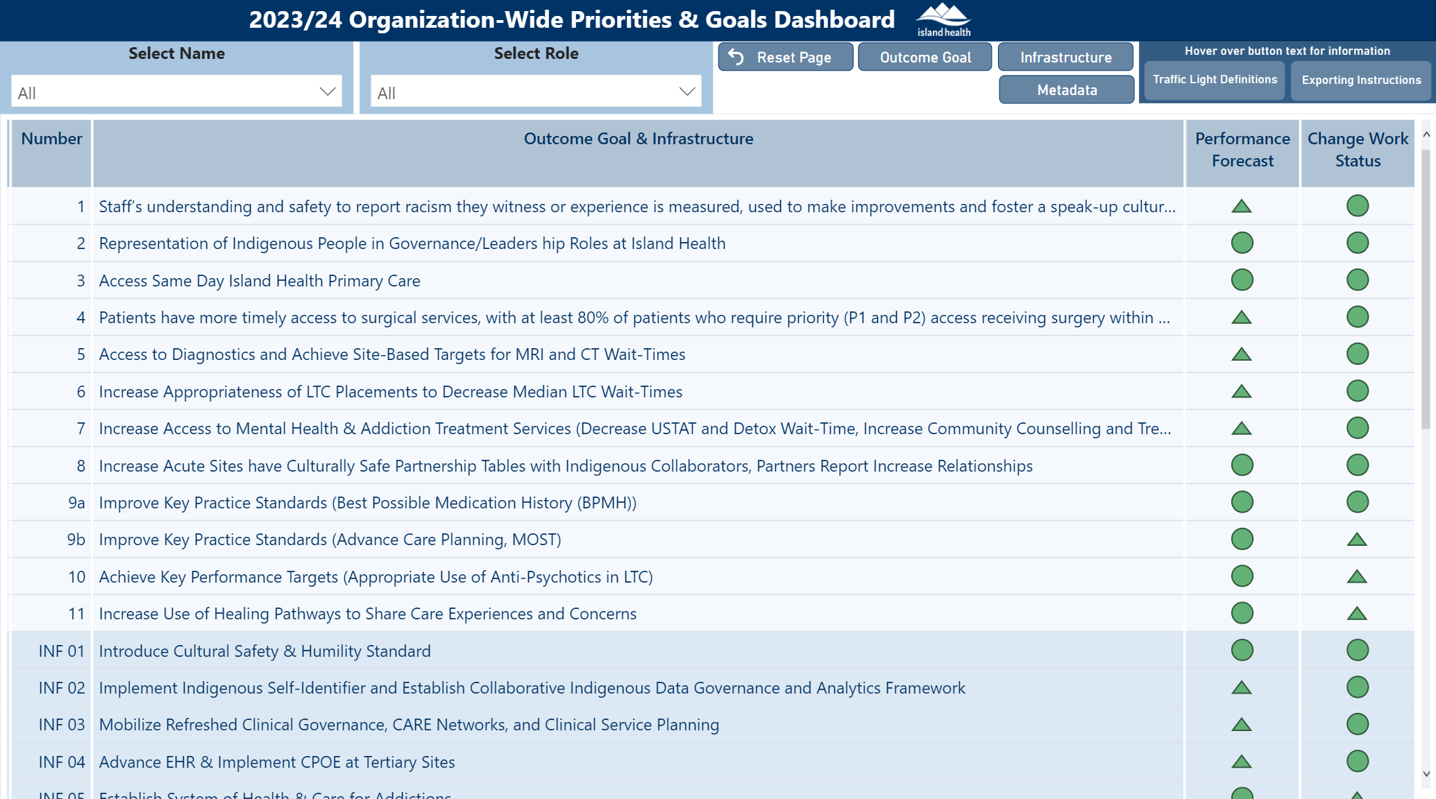
Supports and
tools
Notes:
To support leaders and make it easier to share this information, we’ve created a new Interactive Guide to our 2024-25 Priorities & Outcome Goals that can be presented to teams. Link: Viewing: 2024/25 Priorities & Outcome Goals (affinitylearning.ca)
Visit the Collaboration Site for more information on the 2024-25 plan, dashboard with performance results, additional supports & resources, and keep up to date on project status. Link: Priorities and Outcome Goals - Collaboration Site - Home (islandhealth.ca)

Slide 12

Huy tseep q’u.
Thank you
Notes:
This Framework - our Roadmap - helps create focus and organizational alignment and moves us forward as an organization - closer to our Vision of excellent health and care for everyone, everywhere, every time.
We changed our annual planning approach to bring focus to achievement of outcomes - moving away from work output as the main success measure.
We needed to get to outcomes - results people can see, feel and touch.
And that is exactly what we are doing with our focus on and accountability for achieving outcomes.
In this new approach, we learn each year, pulling forward what works and letting go of things that no longer work to getting to results.
It is with gratitude we acknowledge the efforts of many people across Island Health to get to results this past year and the commitment now we have to get to results in the year to come.

