Slide 1
COVID-19 Anti-viral Medications and How to Prescribe Them
Eric Partlow MD, FRCPC
ID physician, Island Health
Co-chair Infection Management Advisory Committee
Member BC Covid Therapeutics Committee
Medical Lead, Covid Therapeutics, Island Health

Slide 2
Faculty/Presenter Disclosure
.
Faculty: Eric Partlow
Relationships with financial sponsors: None
Notes:
This slide must be visually presented to the audience AND verbalized by the speaker.

Slide 3
Outline:
New therapies for mild/mod covid-19
  Sotrovimab IV infusion
  Paxlovid – oral antiviral
  Remdesivir (short course) – IV antiviral
Provincial data and treatment eligibility criteria
Provincial Covid Virtual Clinic – CATe line
  Ministry of Health provincial Paxlovid rollout
OCTC (Outpatient Covid Therapeutics Clinic) in Island Health
  Sotrovimab infusion clinics in Island Health
Practical aspects of patient assessment and management
Support and resources for assessment and prescribing

Slide 4
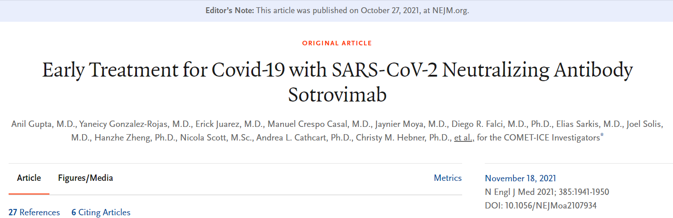
standard Double blind, randomized, placebo-controlled study
Phase 3 only
Aug 2020 – March 2021
4 countries (US, Canada, Brazil and Spain)
Very generalizable population

Slide 5
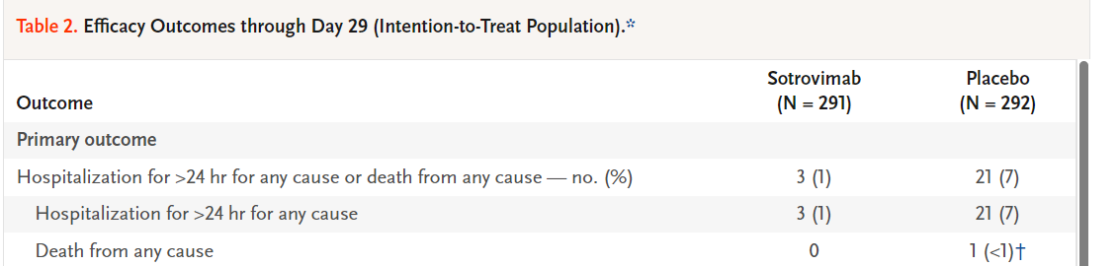
Sotrovimab (Xevudy)
Monoclonal antibody against spike protein
  Large binding domain; maintained activity against Omicron
Dosed 500mg IV x 1 dose IV infusion over an hour plus observation
Evaluated in a randomized, double-blind placebo-controlled trial (COMET-ICE); similar to EPIC-HR (except all-cause primary endpoint)
Source: N Engl J Med 2021; 385:1941-1950 DOI: 10.1056/NEJMoa2107934

Slide 6
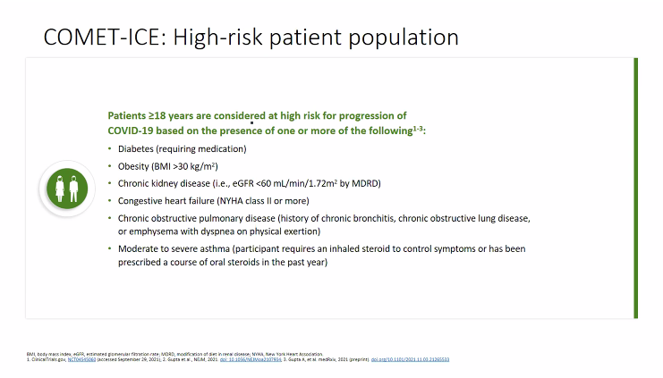

Slide 7
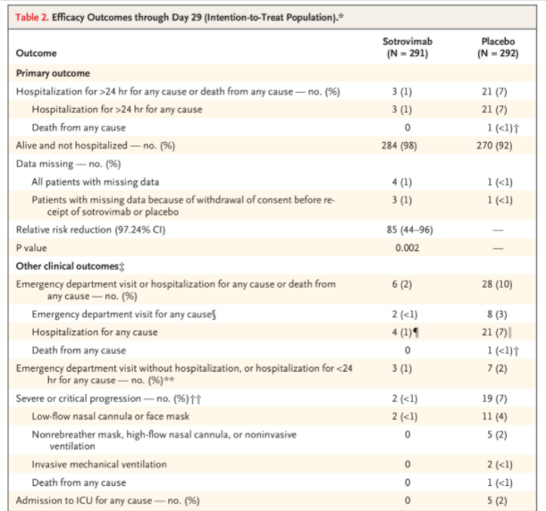
Primary end-point from interim
1% vs 7% event rate
ARR of 6%
RRR 85%
NNT 17

Slide 8
Considerations/challenges with sotrovimab?
Clearly a potent drug in that study population
Well-tolerated with few contraindications and no DDIs
Infusion time and operational challenges (e.g., location, IPC issues, staffing, geography)
High-cost therapy comparatively - $1800
Unclear evidence for those who are immuno-competent or vaccinated as patients have or produce their own antibodies; data in seropositive patients is mixed
Potential for resistance could emerge as seen with other mAbs

Slide 9

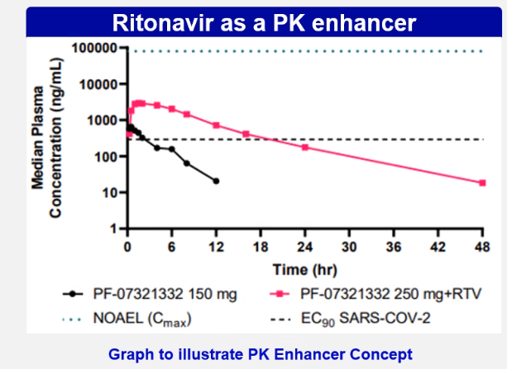
nirmatrelvir/ritonavir (Paxlovid)?
Protease Inhibitor (PI) specific to SARS-COV-2
Active against all variants of concern, including Omicron
No measurable activity against human proteases; genotoxicity and mutagenicity not observed; similar side-effects to other PIs
Extensively metabolized by CYP 3A4
  T1/2 = 2hrs alone; extended by ritonavir
  Nirmatrelvir is renally excreted
150mg/100mg nirmatrelvir/ritonavir tabs
  2 tabs/1 tab (300mg/100mg) PO BID
  Kit contains 30 tabs
  Renally adjusted for eGFR 30-60m/min
    150mg/100mg PO BID

Slide 10
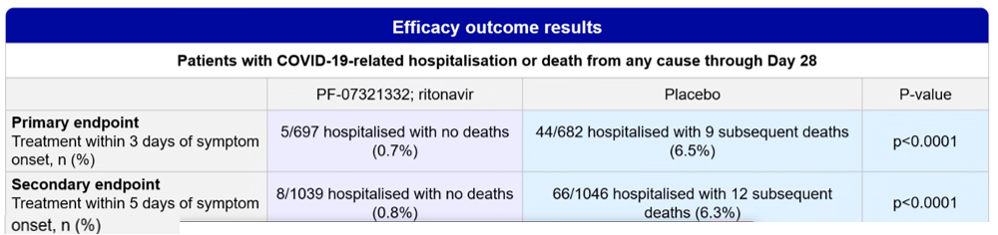
EPIC-HR Study ; nirmatrelvir/ritonavir (Paxlovid)
Prior to publication, Health Canada issued a full Notice of Compliance
Randomized, double-blind placebo-controlled trial
  Conducted globally (41% participants from the US); 95% Delta VoC
  Unvaccinated adults with mild-moderate COVID-19 at high-risk of progression
    Age ≥ 60 or an at-risk condition (obesity, current smoker, heart disease, diabetes)
    Randomized within 3 days of symptom onset, increased to 5 days after ~1/3 of ppt enrolled
Primary end-point: 89% RRR; 5.8% ARR and NNT 17
Source: Pfizer

Slide 11
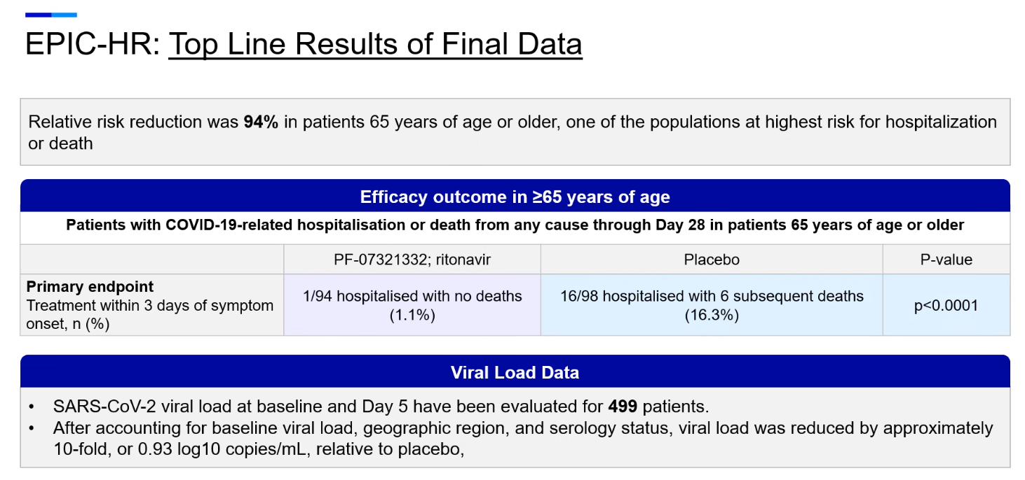

Slide 12
DDIs
Very long list of DDIs spanning most classes of therapeutics
Key examples include:
  Antiarrhythmics like amiodarone and dronedarone (could consider holding)
  CCBs like amlodipine, diltiazem, nifedipine (can usually give, just monitor or ↓)
  Anticoagulants like rivaroxaban and apixaban (can change to dabigatran in certain people; pay special attention to cancer patients)
  Statins like lovastatin and simvastatin (can hold)
  Various anticancer drugs especially tyrosine kinase inhibitors, paclitaxel IV (not on P’net), venetolax, couple of oral anti-androgen agents (call BCCA pharmacy)
  Antiplatelet agents like clopidogrel (could give if low risk) and ticagrelor (“No”)
  Antipsychotic agents like lurasidone and clozapine (hard no)
  Sleeping medications like zopiclone and benzodiazepines (can hold or reduce)
  Inhaled salmeterol (odd one but do not co-administer due to cardiac ADRs)
  Antiepileptics such as phenytoin and carbamazepine are inducers and are a “No”

Slide 13
Common drugs that are OK
Beta-blockers
PPIs
ACE-Is and ARBs
SSRIs
There are drugs in every class that are OK (e.g. risperidone for antipsychotics)
HIV drugs (keep calm and carry on even if DDIs)

Slide 14
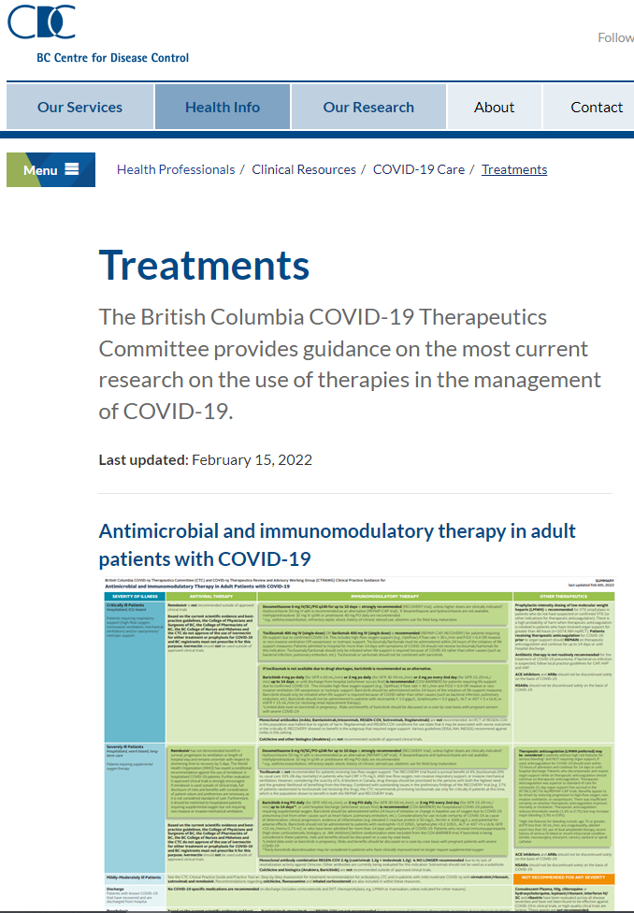

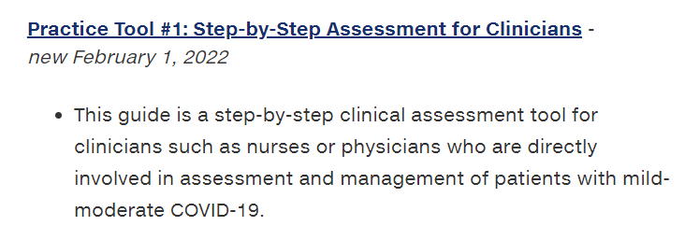
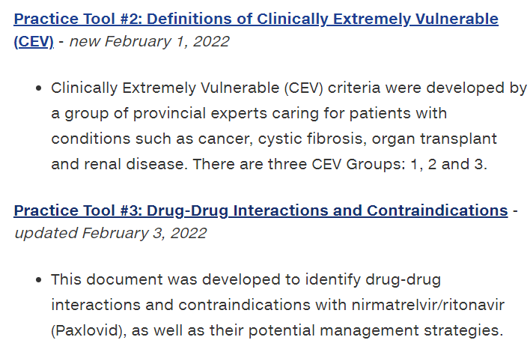
Resources
Clinical Practice Guide and Tools on BCCDC website
Google “covid therapeutics BCCDC”

Slide 15
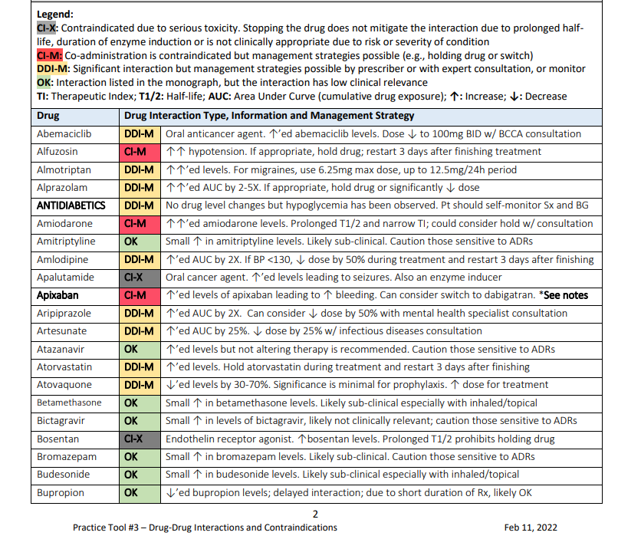

Slide 16
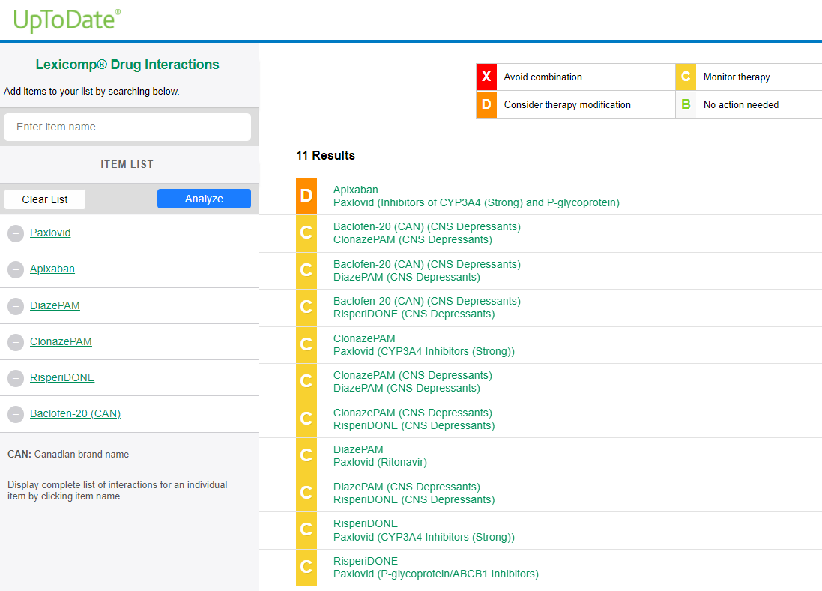
Drug Interactions – in Lexicomp database

Slide 17
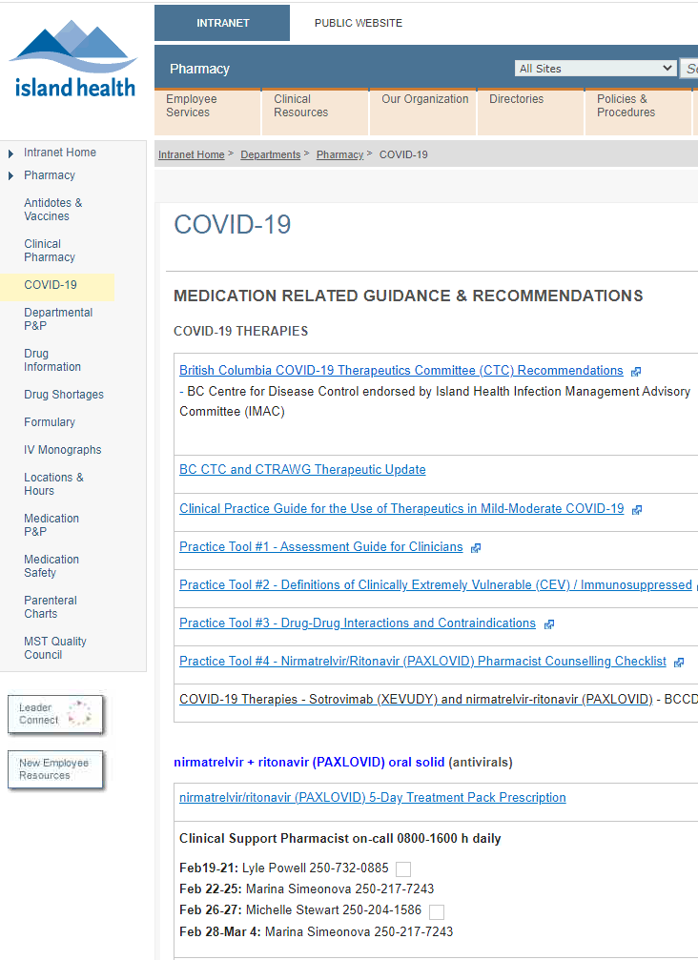
Pharmacy Support
Pharmacy support line – BC virtual Covid Clinic
  Call 1-866-604-5924 Monday to Friday 8:30-4:30
  Be ready to provide:
    Your caller details: name, phone number, city where they practice, and when we can call back that they will pick up
    Patient details: Name DoB, PHN, relevant medical info
Local HA pharmacy support:
  Covid clinic support pharmacist
  In VIHA intranet/clinical resources/pharmacy home/medication related docs and guidance
Retail Pharmacy
  Dispensing pharmacist will have to assist

Slide 18
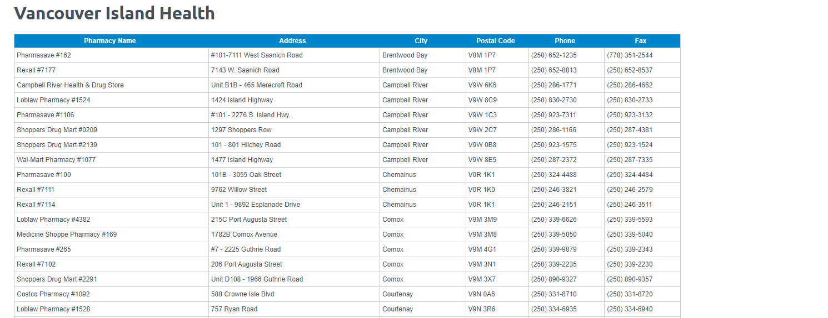
Island Health Pharmacies with Paxlovid
93 pharmacies so far
A few gaps but working on it
https://www.bcpharmacy.ca/paxlovid/list

Slide 19
Patient selection and eligibility criteria
The study populations were different than the real world patients
  relatively healthy
  younger
  Unvaccinated populations.
How did we decide who should be treated?
Excellent database of compromised patients.
Provincial data on hospitalization
Used multivariable analysis to determine risk of hospitalization

Slide 20
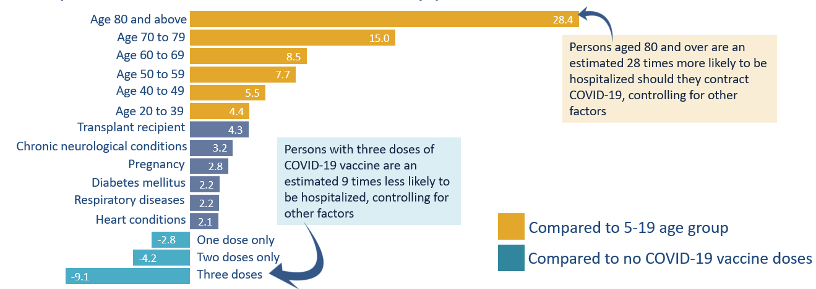
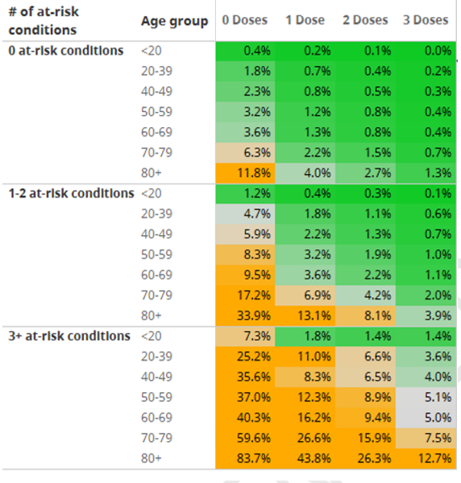
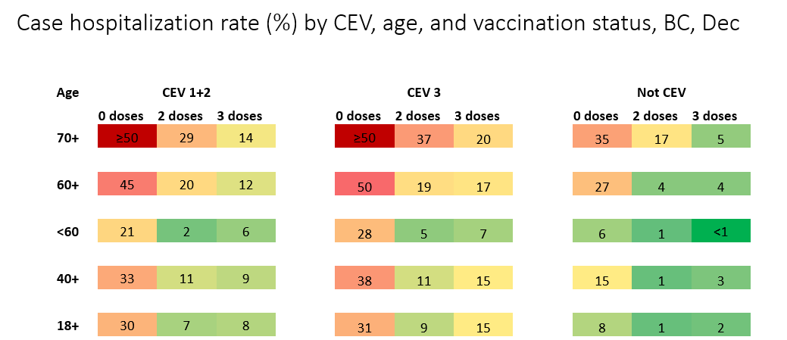
Evidence for Multivariable Inclusion Criteria
BC-specific modeling; Omicron wave. BCCDC/HSAIR

Slide 21
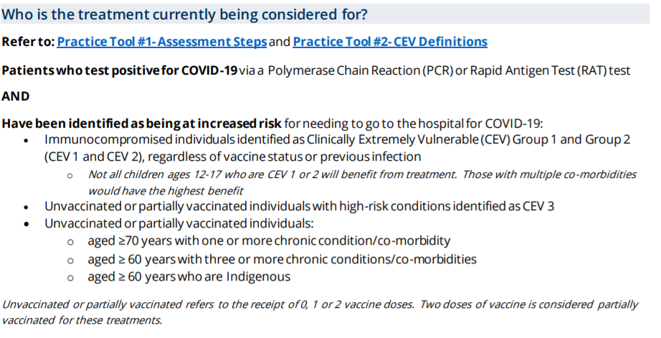
Focus on those with the most likelihood of benefit
Highest-risk individuals (~15% progression to severe illness)

Slide 22
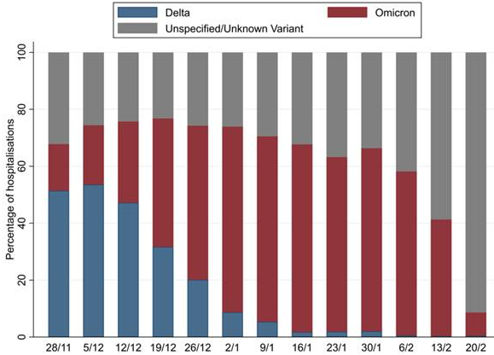
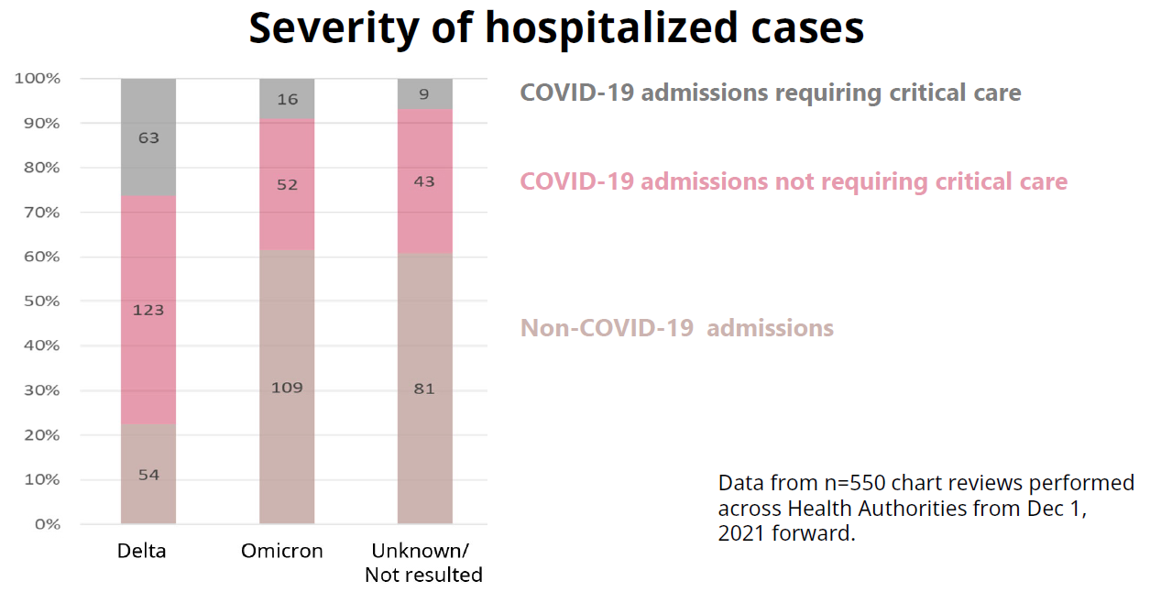
Only since the beginning of January, the majority of hospitalizations in BC were Omicron; ~40% were primarily for COVID-19
Red: Study period of previous thermal map;
Yellow: New study period

Slide 23
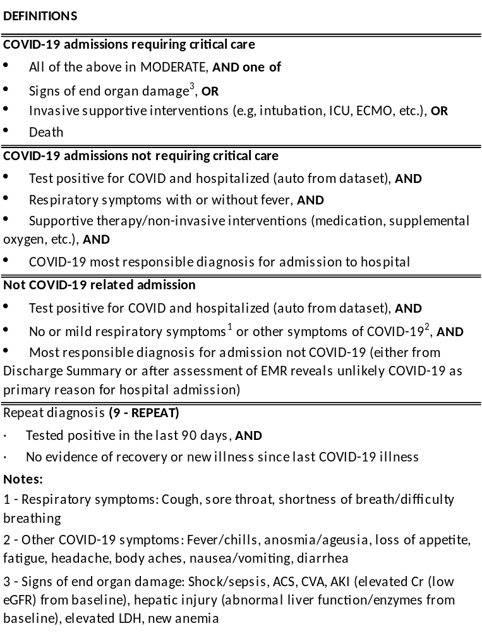
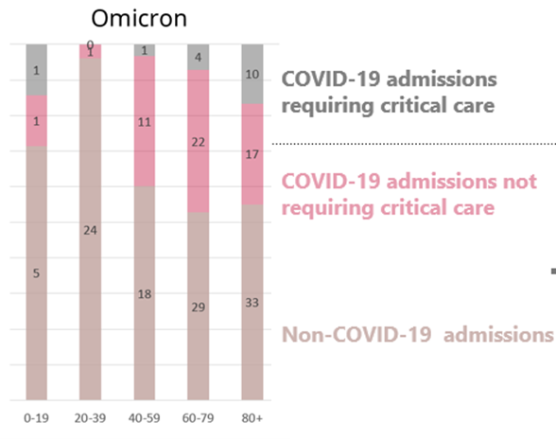
Results from HA chart review showed that % primarily for COVID differs by age
Primarily for COVID
Primarily for other conditions, with COVID
Methods
Chart review via CareConnect using standard data extraction tool
Stratified random sample of hospital records from PCR lab confirmed cases from all 5 regional HAs reported between 1 Dec 2021 to 15 Jan 2022
  Hospitalizations proportionally related to the time period and % hospitalized by HA
  Hospital charts for those who were part of acute care outbreaks not specifically excluded, but represent ~5% of patients
Record of hospital admission either in HA linelist or PCMS episode

Slide 24
Estimated % hospitalizations that are likely primarily for COVID-19, based on results of HA chart review
Age | CEV Group 1 |  | CEV Group 2 & 3 |  | Not CEV
 | 0 doses | 1+ doses | 0 doses | 1+ doses | 0 doses | 1+ doses
18-49 | 90% | 50% | 80% | 40% | 50% | 20%
50-59 | 100% | 90% | 90% | 60% |  | 30%
60-69 |  |  |  |  | 70% | 35%
70+ |  |  |  |  |  | 40%
Please interpret with caution as these are estimates only, based on relatively small sample size. Bold font indicates estimates with higher level of confidence.
Please note that chart review is ongoing and not finalized yet; therefore the results are preliminary

Slide 25
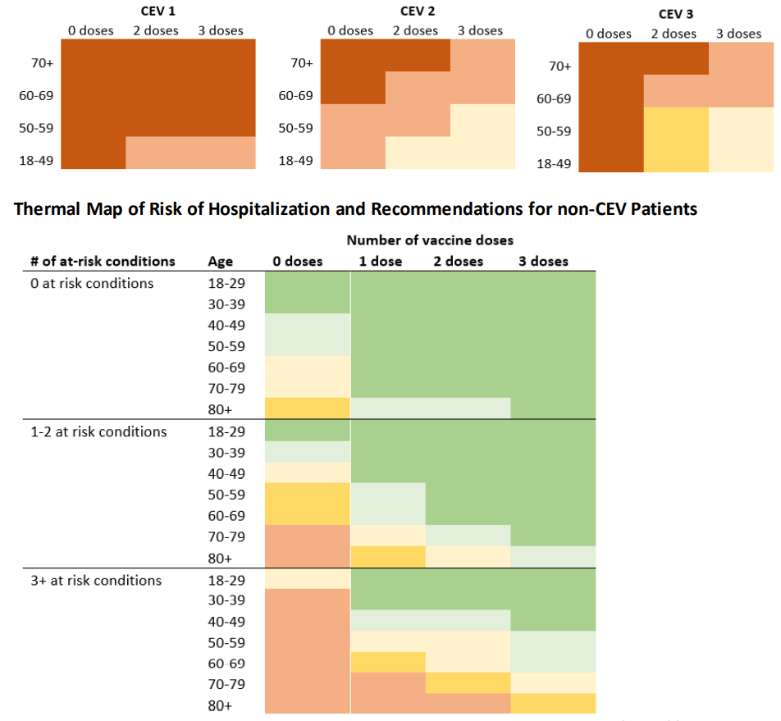
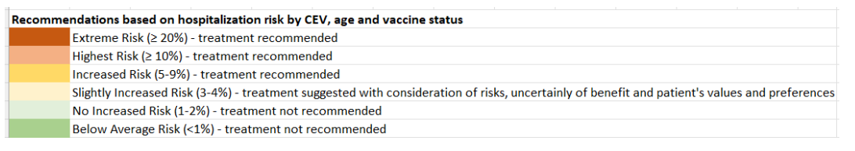
Thermal maps
- omicron data
- corrected for hospitalization

Slide 26
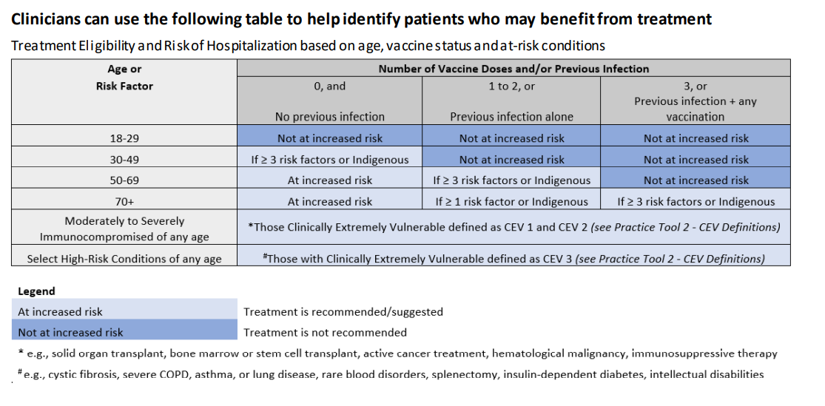

Slide 27
Step-by-step clinical assessment
Detailed assessment of risk factors:
  Age-associated risk - significant
  Immunocompromise – CEV 1 and 2
  Vaccine status
  Comorbidities – type and number
  Clinical Status – symptoms, severity, trajectory
Notes:
Omicron is highly variable in clinical presentation
Overall risk can be challenging to estimate
Not all patients are easily classified

Slide 28
Assess Clinical Syndrome (symptoms)
Mild to Moderate Disease – symptomatic but not needing O₂ therapy
Severity types simplified:
  Do not treat asymptomatic patients
  “Cold” – sore throat, HA, congestion
    Very mild 2-3 day illness for most vaccinated patients
  “Flu” – severe HA, fever, myalgias, N/V, diarrhea
    May be nearly bedridden
  “Pneumonia/LRTI”- dyspnea, SOBOE, cough
    May still not need O2
Also consider symptom trajectory and symptom window
  Those who are visibly improving on their own
  Role for observation if early, mild, or improving
  Time for drug transport can be added to the symptom window for patients from rural/remote communities

Slide 29
Paxlovid Staged approach to implementation
Wave 1: Clinical teams primarily utilizing Infectious Disease services, but also BC Renal, BC Cancer, BC Transplant, and Cystic Fibrosis Care BC. FNHA to receive support from health authorities.
Wave 2:
Long Term Care and Assisted Living
Emergency Departments
Wave 3:
COVID Antiviral Therapeutics e-team (CATe)
Expanding to other specialists (such as: rheum, neuro, cardio, resp medicine, etc)
Corrections and Mental Health Facilities – congregate settings
Homeless or in temporary housing/marginalized communities
Wave 4:
Community family physicians and nurse practitioners

Slide 30
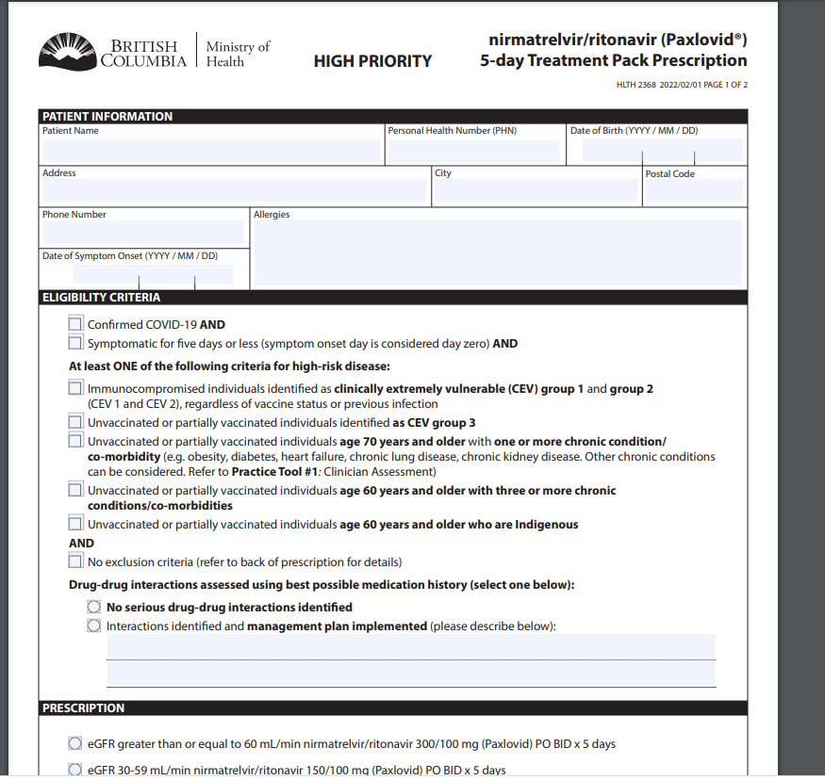

Slide 31
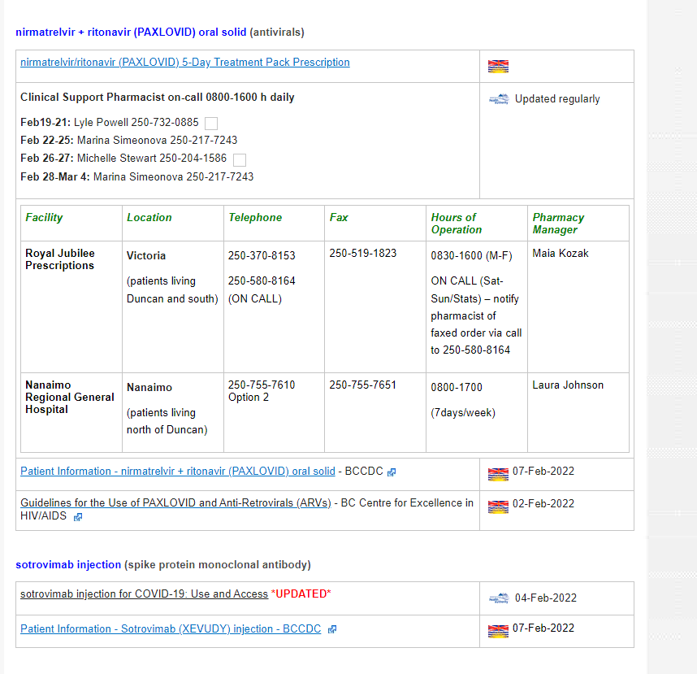
Paxlovid prescription
On the Pharmacare special authority website - PDF
On the Island Health intranet – pharmacy PDF
Island Health e-form/CPOE
Provincial eForm – if registered with pharmacare
Eventually dispensed form various retail pharmacies

Slide 32
Support for Physicians
Pharmacy support line – BC virtual Covid Clinic
  Call 1-866-604-5924 Monday to Friday 8:30-4:30
    Be ready to provide:
    Your caller details: name, phone number, city where they practice, and when we can call back that they will pick up
    Patient details: Name DoB, PHN, relevant medical info
Local pharmacy support:
  Covid support pharmacist – on intra-net/pharmacy/covid therapeutics
  call OCTC for contact info
ID service – regional; 24/7 south Island
OCTC referral: 250-737-2030- ext 44685

Slide 33
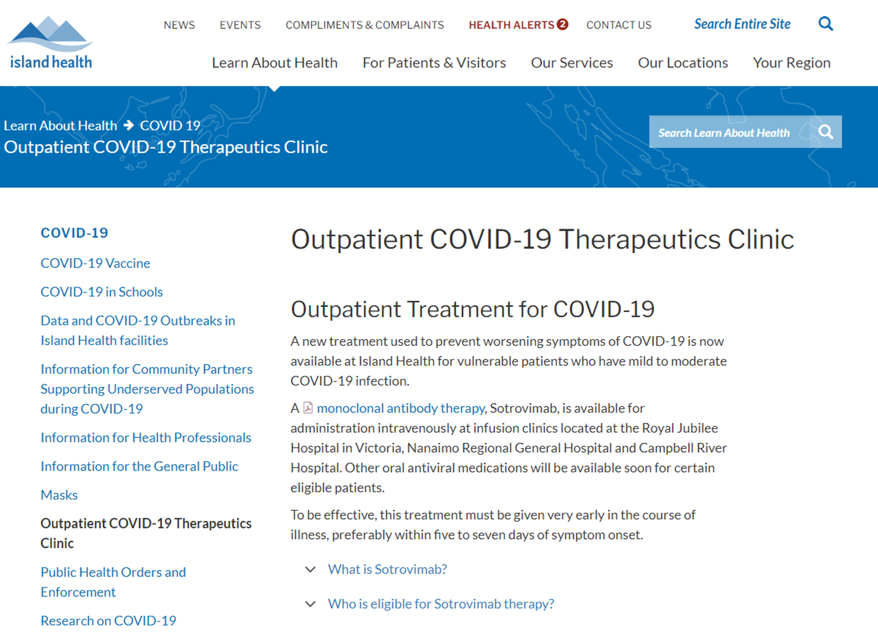
OCTC in Island Health
Primary clinic – CDH and RJH
  Unit clerk/NUA
  Call center nurses – phone calls, followups
  nurses doing screening
4 infusion clinics – RJH, NRGH, CRH, WCGH
  Medical daycare; ER as overflow
  More sites pending
Public Health and Data Analysts run daily algorithm captures
  CEV 1-2
  CEV 3
  Inadequate vaccine > 60 yrs

Slide 34
OCTC clinic: 250-737-2030 ext 44685
Refer for assessment
Especially if sotrovimab likely
  DDI
  Transplant, CEV1, cancer treatment
Patients may call directly (after reviewing criteria on website)
Physicians may call; leave a message - patient info, Dx.
No direct physician support – other than LTC
Island ID physicians for clinical case review
All patient and physician referrals will be reviewed by nurse/pharmacist
Virtual visit with Physician booked
  Paxlovid Rx
  Sotrovimab infusion booking

Slide 35
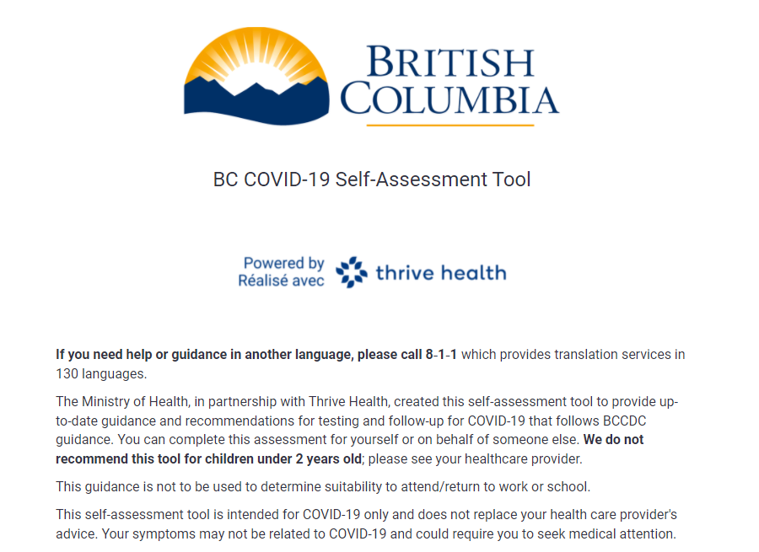
Referrals to BC Covid clinic 1-888-COVID19
Patient Direct self referrals:
  Website First – BC site and the Island Health OCTC site
    Then Call: patients self screen then call
    PCP or specialist provider
    Paxlovid - predominantly the BC clinic CATe line
    OCTC Especially if possible/likely sotrovimab candidate
Physician referrals – not the CATe line
  No peer support
  Within the health authority only
  Call OCTC leave a message

Slide 36
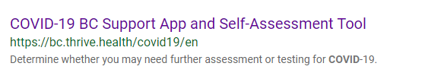
Information for Patients
The BC Covid website patient screening questionnaire
Call the BC Clinic number
1-888-268-4319 (1-888-COVID-19)
Check the Island Health OCTC website for treatment criteria, drug information and call if eligible
1-250-737-2030-ext44685

Slide 37
Primary Care options – patient meets criteria
Definite paxlovid contra-indications: refer to OCTC for sotrovimab
  Leave a message if after hours
No major issues/DDI’s – prescribe Paxlovid
  Print Rx, Fax, drug delivered by courier to home
  OR direct patient to the BC website and central clinic for self screen
Need pharmacy review – call a pharmacist –
  BC pharmacy support line
  Local VIHA pharmacy support (for another couple weeks)
  Destination community pharmacy
Need clinical review - Call ID to discuss clinical case
  We will discuss and advise; not prescribe unless actually see patient.

Slide 38
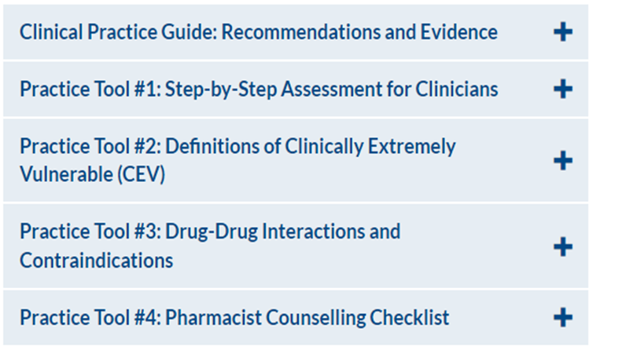
Resources: BC CDC website Covid Treatments

