Slide 1
Public Health Grand Rounds: Respiratory Illness Season Update 2025
29 OCTOBER 2025
Dr. Mark A. Cachia, MD, MPH, FRCPC​
Dr. Christina Kay, MD, MSc., FRCPC​
Excellent health and care for everyone, everywhere, every time.

Slide 2


Territorial Acknowledgement
Island Health acknowledges with respect and humility the Coast Salish, Nuu-chah-nulth and Kwakwa̱ka̱ʼwakw Peoples on whose unceded traditional territories we offer our services and programs.
As a health organization, we are committed to identifying and addressing the historical and ongoing health impacts of colonization and Indigenous-specific racism to promote a culturally safe work environment.

Slide 3



Presenters

Slide 4
Conflict of Interest
No financial relationships with sponsors or vaccine industry
Notes:
MAC - ¼ Provincial TB Committee, SORC, STIBBI Task Group, PPH Quality, IPAC/OHS X-Continuum

Slide 5
Acknowledgements
Slides from Dr. Meena Dawar, Medical Health Officer at Vancouver Coastal Health
Population & Public Health:
  Education & Practice Support
  Population Health Assessment, Surveillance & Epidemiology
  Immunization Team

Slide 6
Objectives
Respiratory Illness Season Update 2025
Review last respiratory illness season in BC
Describe current activity for influenza, COVID-19 and RSV
Highlight provincial immunization guidelines 2025
  Influenza
  COVID-19
  Pneumococcal
  RSV
Q&A

Slide 7
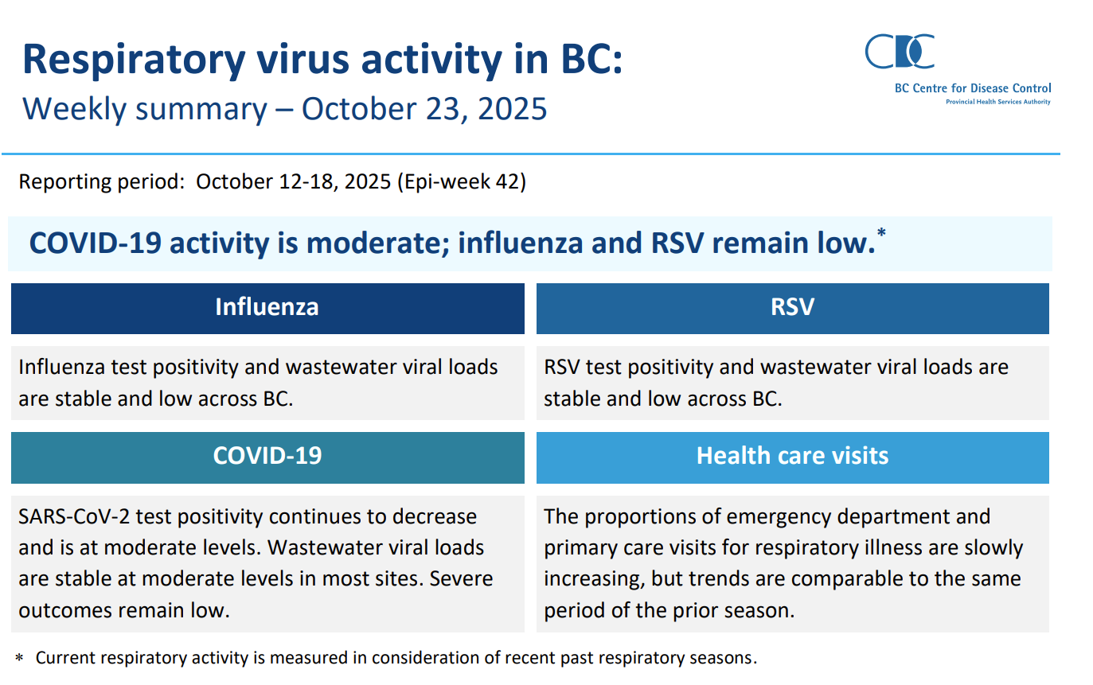
Snapshot of Respiratory Virus Activity
https://www.bccdc.ca/Health-Info-Site/Documents/Respiratory_data/respiratory_virus_activity_2025-10-23.pdf

Slide 8
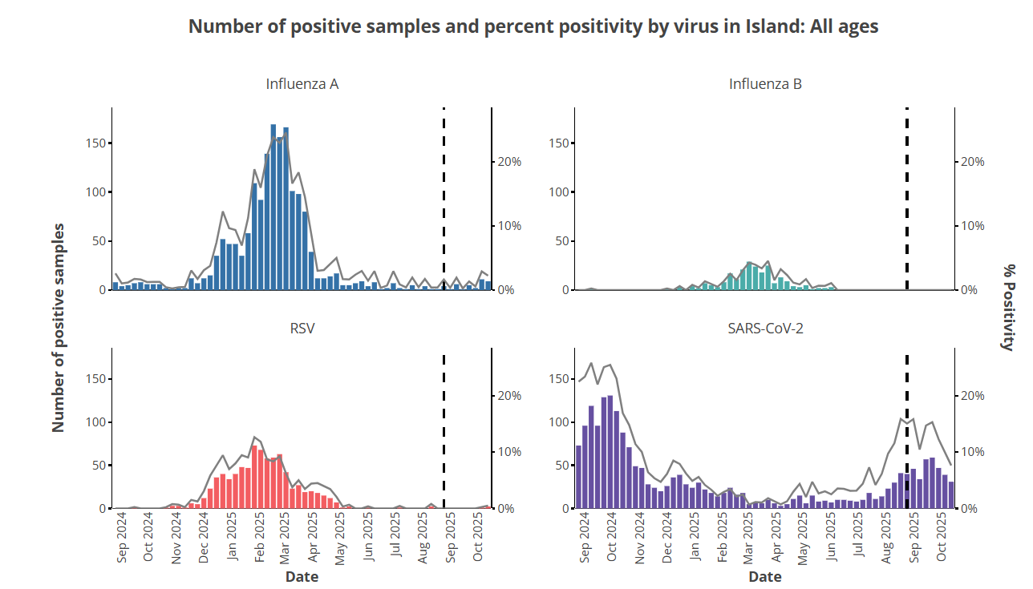
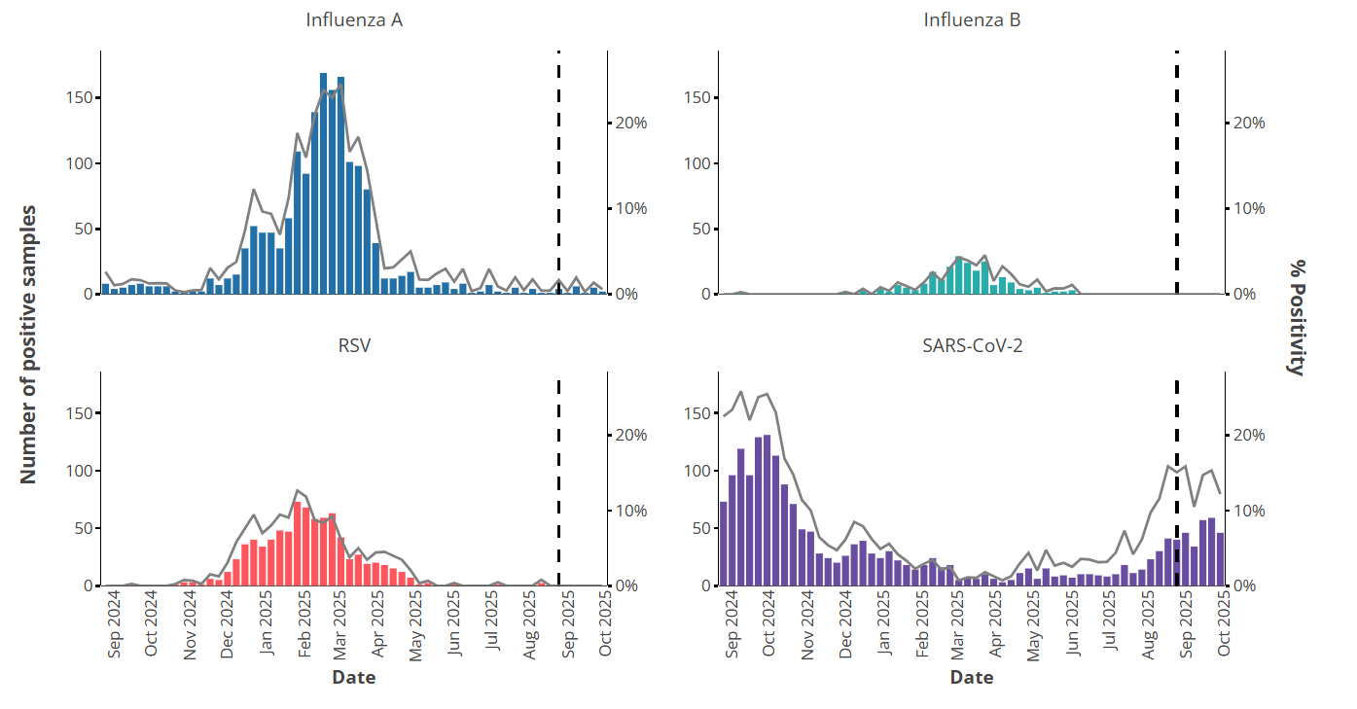
Number of Positive Samples and Percent Positivity by Virus: ISLH
While Influenza A, Influenza B, and RSV typically peak in the late winter to early spring, COVID-19 does not follow the same seasonal pattern.
In the 2024/25 season, COVID-19 activity fluctuated with peaks in late summer and early fall.
Dashed line denotes the beginning of the 2025/2026 respiratory season.
Data source: BCCDC Respiratory Surveillance: Viral Pathogen Characterization Dashboard, Viral Pathogen Characterization (Oct 27, 2025)

Slide 9
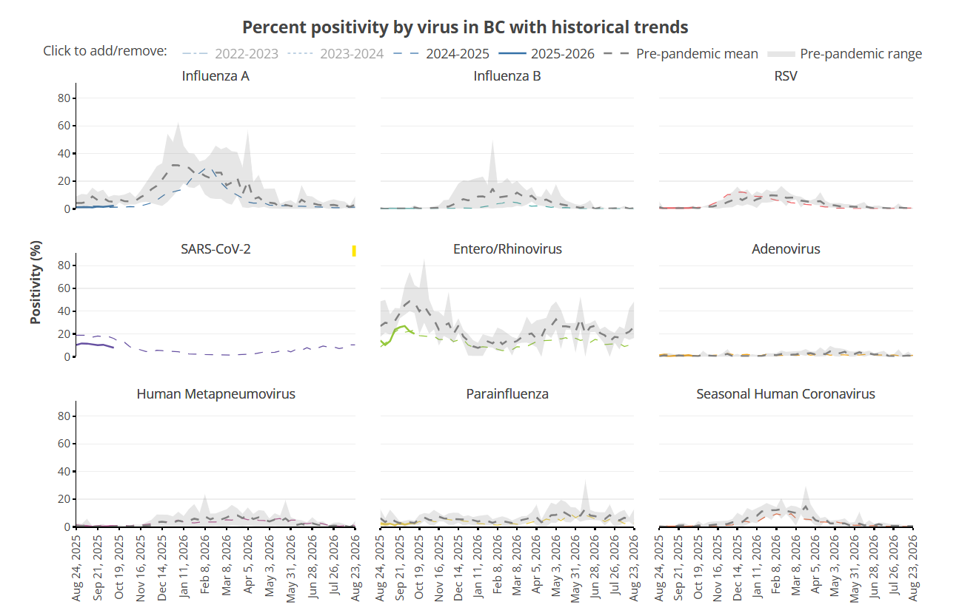
Respiratory viruses in BC with historical trends
Data source: BCCDC Respiratory Surveillance: Wastewater Surveillance Dashboard, Wastewater
Data source: BCCDC Respiratory Surveillance: Wastewater Surveillance Dashboard, Viral Pathogen Characterization (Oct 27, 2025)

Slide 10
Healthcare Visits for
Respiratory Outcomes

Slide 11
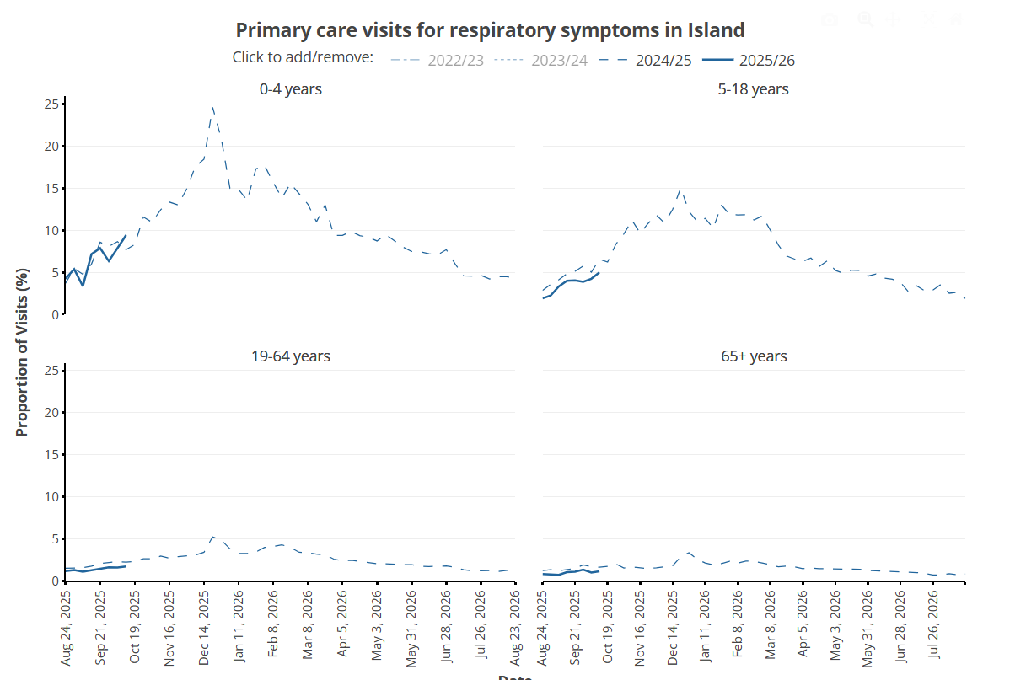
Primary Care Visits for Respiratory Symptoms: Adult and Pediatric, ISLH
Data source: BCCDC Respiratory Surveillance: Primary Care Visits for Respiratory Illness Dashboard, Health Care Visits for Respiratory Illness (Oct 27, 2025)

Slide 12
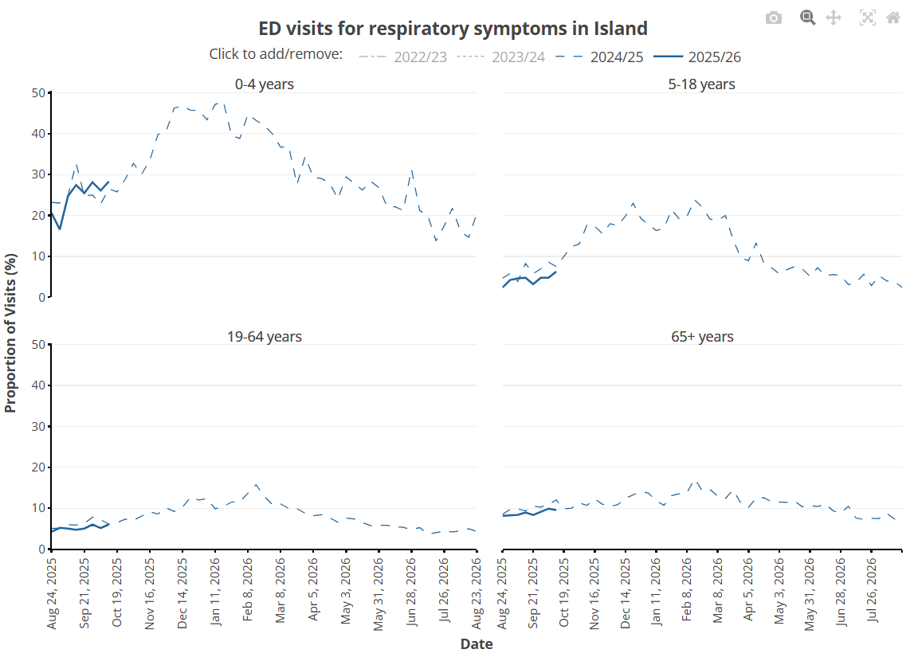
ED Visits for Respiratory Symptoms: Adult and Pediatric, ISLH
Data source: BCCDC Respiratory Surveillance: Emergency Department Visits for Respiratory Illness Dashboard, Health Care Visits for Respiratory Illness (Oct 27, 2025)

Slide 13
Influenza
Vaccine

Slide 14
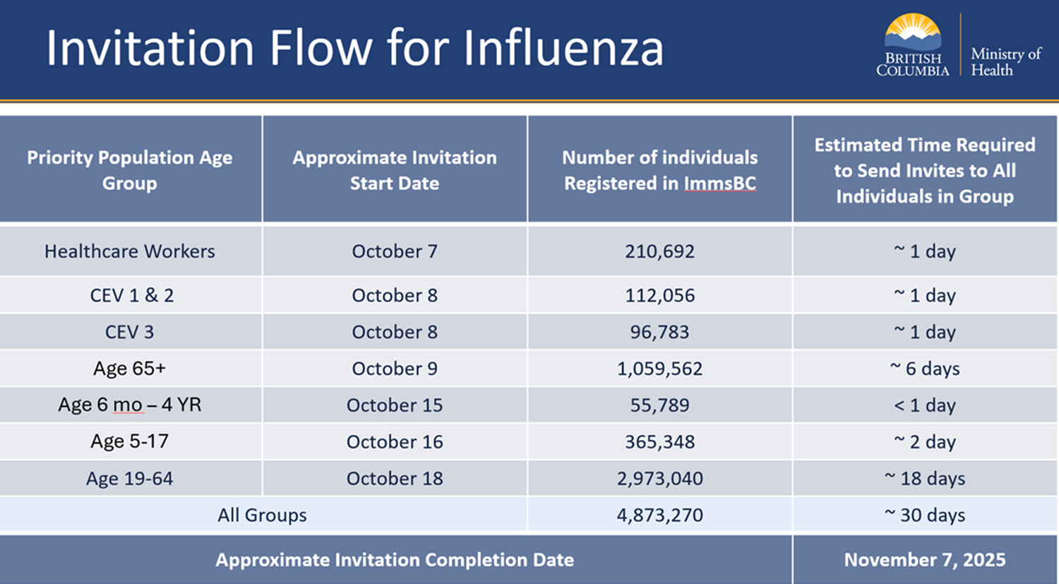

Slide 15
Updated influenza and COVID-19* vaccines are available this fall for all British Columbians 6 months and older
  Both vaccines are recommended for the following:
    People aged 65 years and older
    People of any age who are residents of long-term care facilities (LTC), assistant living facilities, clients waiting placement in LTC
    Indigenous people
    Pregnant people
    People with underlying medical conditions
    People who provide essential community services (health care workers and first responders)
* Reminder: Second dose (spring 2026) recommended for the following: >80 years, residents of LTC homes, > 6mos with immune compromising conditions. 65-79 years may receive a second dose.
  Influenza vaccine only recommendations:
    Children 6 months to 5 years
    Household contacts of people at high risk
    People who interact closely with influenza susceptible animals

Slide 16
Influenza vaccines available this fall
Updated trivalent vaccines:
A/Victoria/4897/2022 (H1N1) pdm09-like virus
A/Croatia/10136RV/2023 (H3N2)-like virus (new)
B/Austria/1359417/2021-like virus
(B/Yamagata lineage strain not seen since 2020 – quadrivalent vaccine not indicated)
Products:
All ages 6mos +: Fluviral®, Fluzone®
Children and youth 2-17 years: Flumist ®
Seniors: Fluad ® (Fluzone-high dose may be available at some pharmacies ~$95)
(There is no combination influenza/COVID-19 vaccine product approved in Canada.)

Slide 17
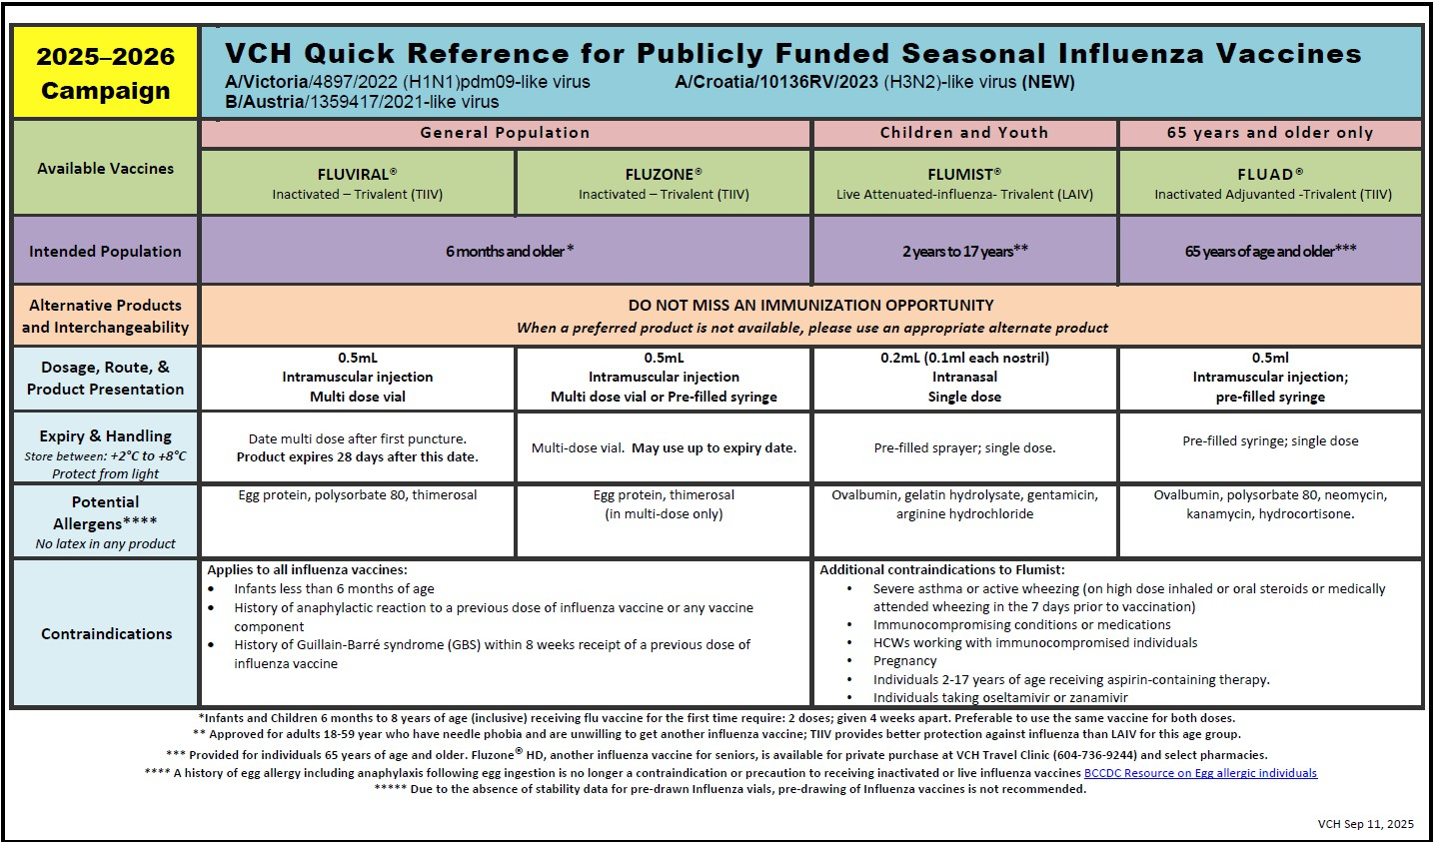
eps-educational-pamphlets-Intake-Questions.docx

Slide 18
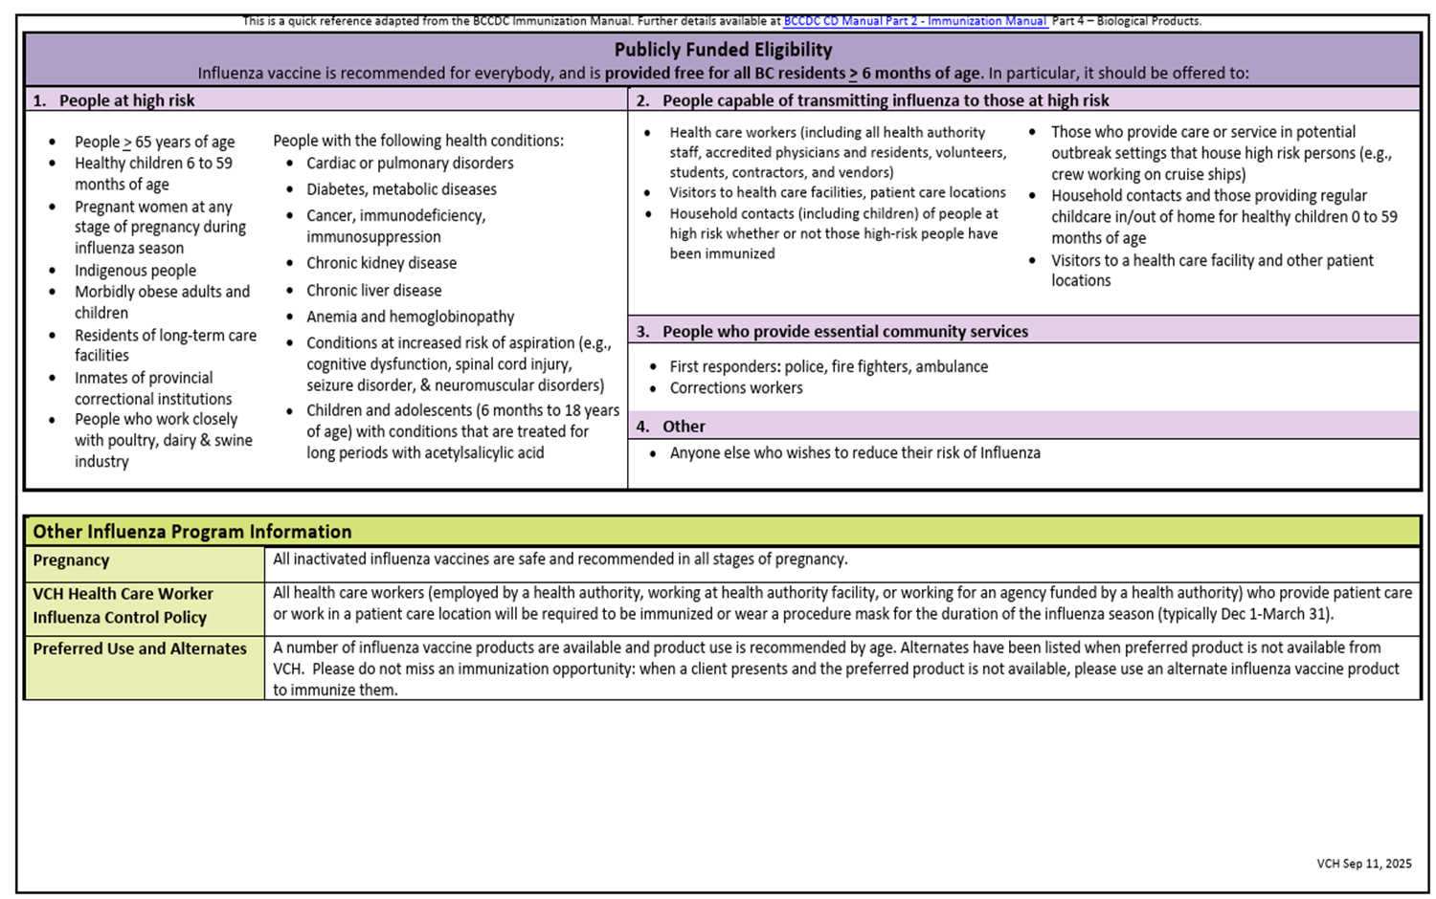
eps-educational-pamphlets-Intake-Questions.docx

Slide 19
Influenza vaccine
Adults and children > 9yo should receive an influenza vaccine annually
Children 6 months-8 years old (inclusive) who have never received influenza vaccine in a previous season should be given 2 doses 4 weeks apart in the current season
  If they have been vaccinated in a previous season, they should receive a single dose this season (and each season thereafter)

Slide 20

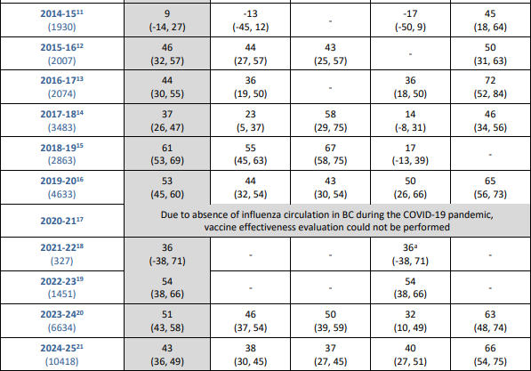
Influenza – Vaccine Effectiveness Estimates
Information from the Canadian Sentinel Practitioner Surveillance Network (SPSN):
For the 2024/2025 season, overall influenza vaccine effectiveness was estimated to be 43% against medically- attended outpatient lab-confirmed infection
  Illness activity was driven by influenza A (87% detections)
  Protection varies by strain
Canadian Sentinel Practitioner Surveillance Network (SPSN) Influenza vaccine effectiveness. Accessed 11 Sep 2025

Slide 21
COVID-19
Vaccine

Slide 22
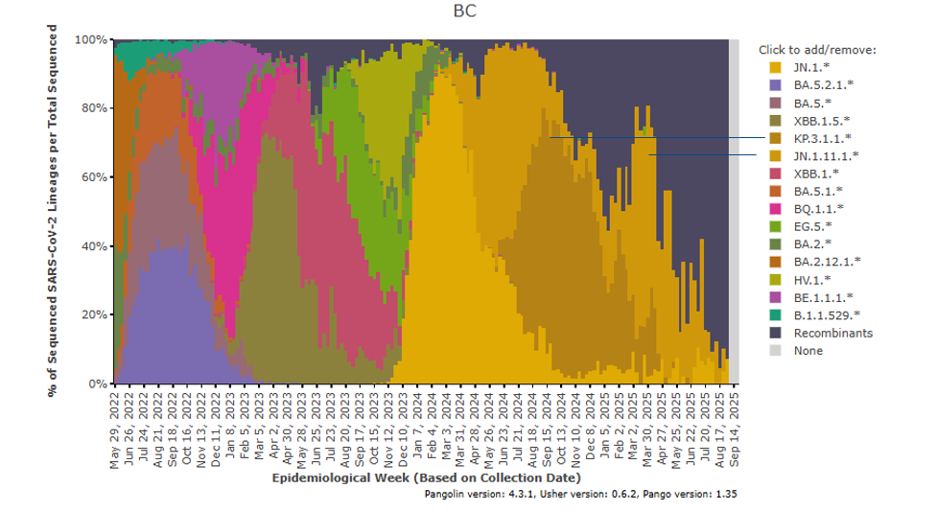
SARS CoV-2 virus is a dynamic, evolving virus
Antigens in Vaccine: 2020 Dec Original strain; 2022 Original/Omicron BA.1 or Original/BA.4/5; 2023 Omicron XBB.1.5 strain; 2024 Omicron KP.2 strain; 2025 Omicron LP.8.1

Slide 23
COVID-19 Omicron Variant Vaccines
mRNA vaccines currently target LP.8.1 variant
  Moderna Spikevax (6 months – 11 years, LTC/AL)
  Pfizer-BioNTech Comirnaty (everyone else)
Efficacy modest
Duration of protection is time-limited (*3-6 months*)
Efficacy against related strains – present, but variable
Vaccine recommended for those at greatest risk of illness (but available to everyone)
(Novavax is not available in Canada this season.)

Slide 24
NACI COVID-19 vaccine recommendations for 2025 to summer 2026
One dose recommended for those at increased risk:
All > 65 years
Those > 6 months who are:
    Residents of LTC/congregate living settings
    Underlying health conditions
    Pregnant
    Individuals in or from FN, I, and Metis communities
    Members of racialized, equity-denied communities
    Health care workers and other care providers
Everyone else may receive a dose
To mitigate the risk associated with waning protection, second annual dose recommended for:
> 80 years
Those > 6 months who:
    Are residents of LTC/congregate living for seniors
    Have underlying moderate or severe immunocompromising conditions
Adults 65-79 may receive a second dose
Summary: Guidance on the use of COVID-19 vaccines for 2025 to summer 2026 - Canada.ca

Slide 25
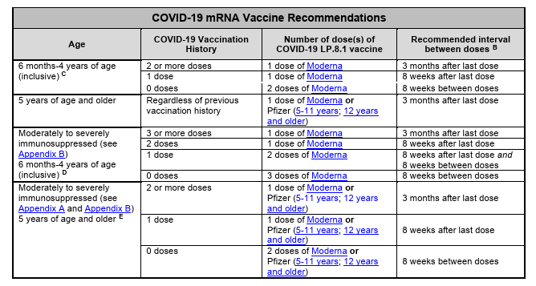
BCCDC COVID-19 vaccine eligibility https://www.bccdc.ca/resource-gallery/Documents/Guidelines%20and%20Forms/Guidelines%20and%20Manuals/Epid/CD%20Manual/Chapter%202%20-%20Imms/Part4/COVID-19-vaccine-eligibility.pdf

Slide 26
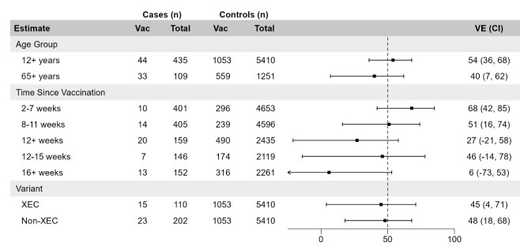
COVID-19 - Vaccine efficacy of KP.2 vaccine against medically attended acute respiratory illness is reasonable but time limited.
Surveillance period: 27 Oct 2024 to 03 May 2025 (n=5845)
VE against COVID-19 illness in individuals 12 years and older was 54%; slightly lower for seniors
L Separovic, et al. Effectiveness of 2024/25 KP.2 vaccine against outpatient COVID-19 in Canada 2025.09.05.25335203v1.full.pdf

Slide 27
Pneumococcal
Vaccine

Slide 28
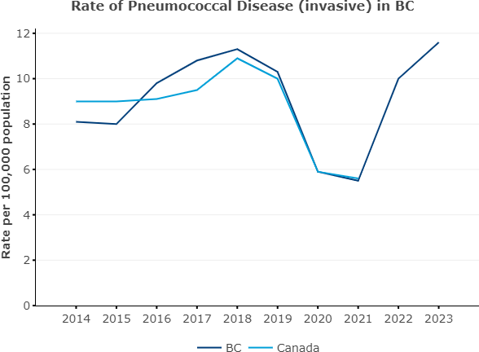
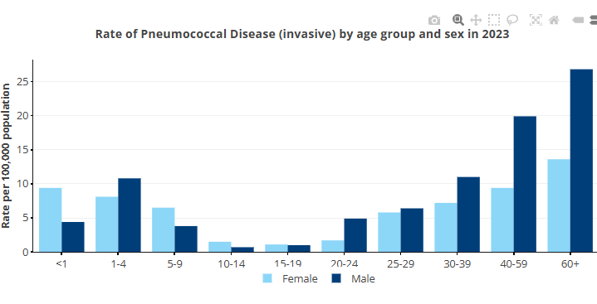
Invasive pneumococcal disease – resurgence in illness
BCCDC communicable disease dashboard, Accessed Sep 2025 Dashboard Disease Dashboard

Slide 29
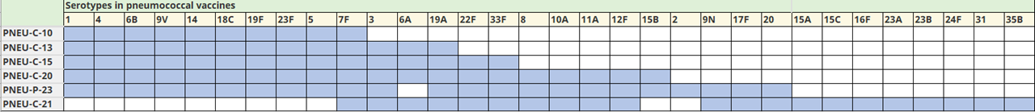
Pneumococcal Vaccine
Publicly funded product was updated in July (2025) to PCV20 (PCV13 and PPV23 products discontinued)

Slide 30
PCV20 eligibility in the context of prior pneumococcal vaccination
Group | Eligibility Criteria
Infants & Children (2–59 months) | Eligible to start or complete pneumococcal series at 2, 4, and 12 months. Medically at-risk infants receive an extra dose at 6 months. PCV13 and PCV20 are interchangeable.
Adults 65+, LTC residents, homeless, substance use disorders | Eligible if they have not previously received PPV23, PCV20, or PCV21.
Active malignant neoplasms, asplenia, organ/islet transplant | Eligible regardless of previous PPV23 history.
Chronic kidney/liver disease, immune deficiencies | Eligible if they have not received 2 doses of PPV23.
Individuals with HIV | Eligible if they have not received PCV13 and two doses of PPV23.
For further details, please see BCCDC PCV20 guidance. Interval from last pneumo vaccine: 8 weeks from PCV, and 1 year from PPV23. **Please return any PCV13, PPV23 left in your office fridges to public health.

Slide 31
Respiratory Syncytial Virus (RSV)

Slide 32
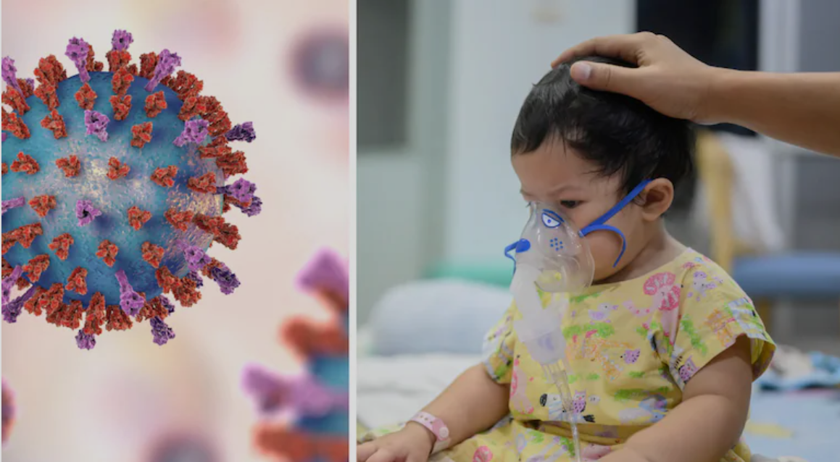
RSV in Children
70% are infected in the first year of life and nearly all (97%) by age two years
30-40% of primary infections result in lower resp tract infection (bronchiolitis/pneumonia)
2-3% require hospitalization
Hospitalization rate in preterm infants is 3x that of term infants
Higher mortality than influenza in infants

Slide 33
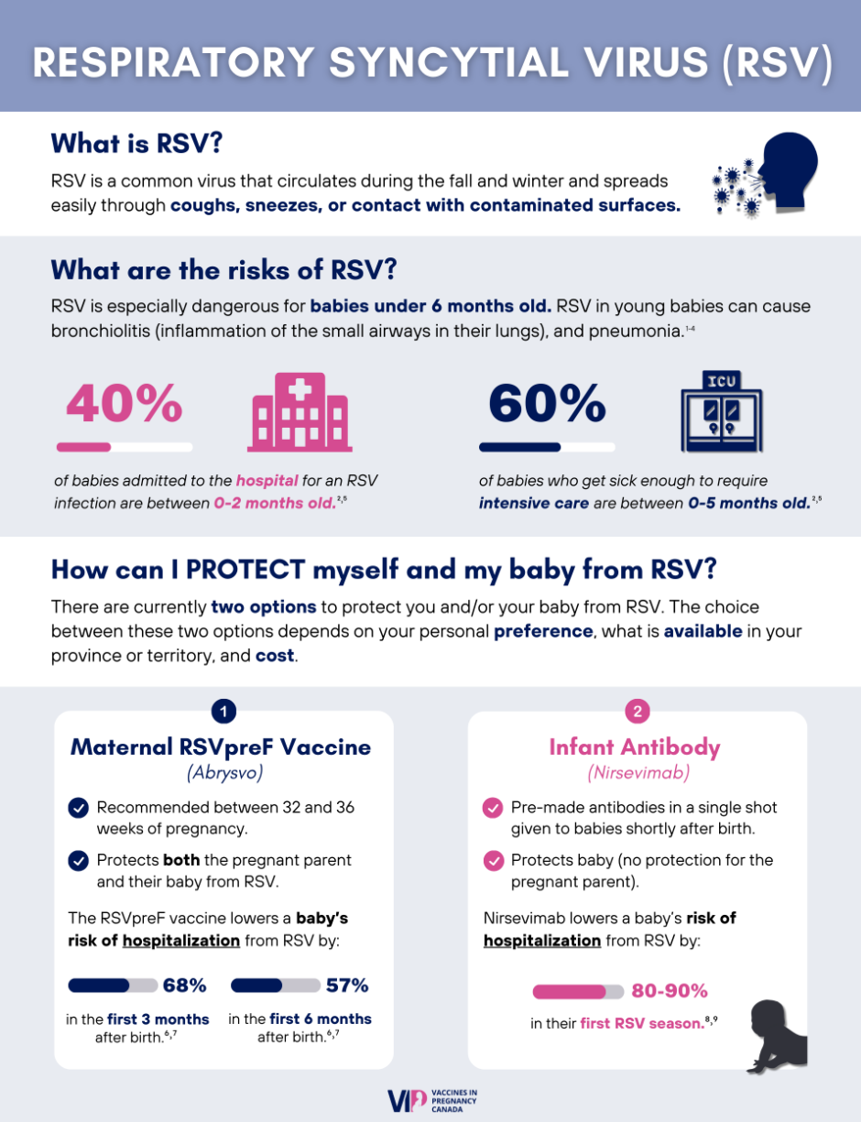
Respiratory Syncytial Virus (RSV)

Slide 34
2025-2026 BC Nirsevimab
Eligibility Criteria
The following infants entering their first RSV season
Premature:
  28 to 34 weeks of gestation and born after Mar 31, 2025
  <28 weeks and discharged from birth hospital
Chronic medical conditions
Under 6 months of age in remote communities (including isolated Indigenous communities)
Under 6 months of age living in congregate settings such as supportive housing
The following infants entering their second RSV season
All children born <28 weeks of gestation (born after March 31, 2024)
More information available at the Perinatal Services BC Perinatal and Newborn Hub: RSV Infant Immunoprophylaxis | PHSA Hub

Slide 35
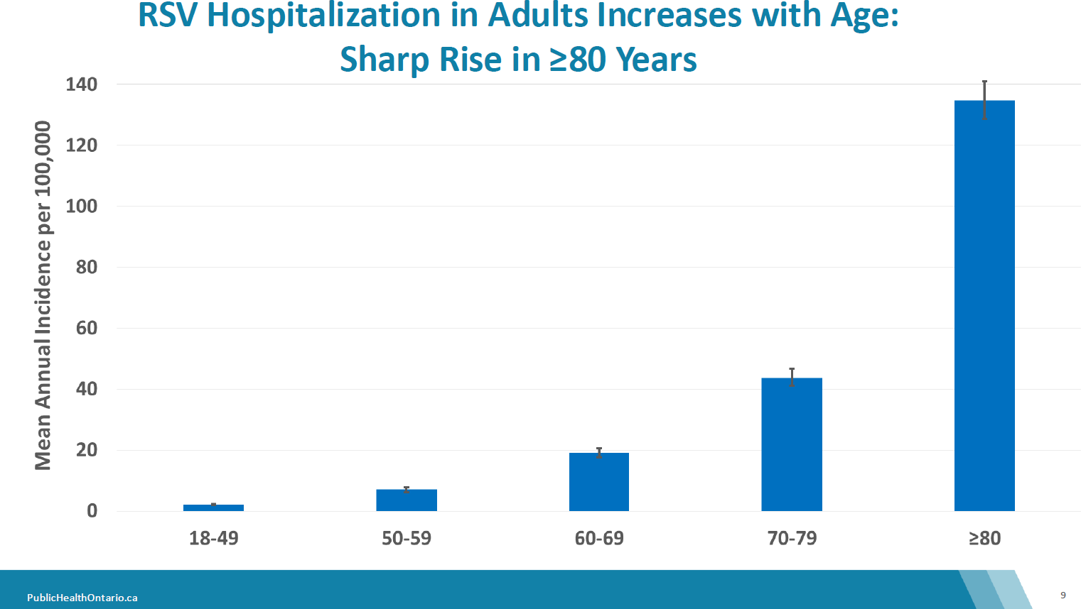

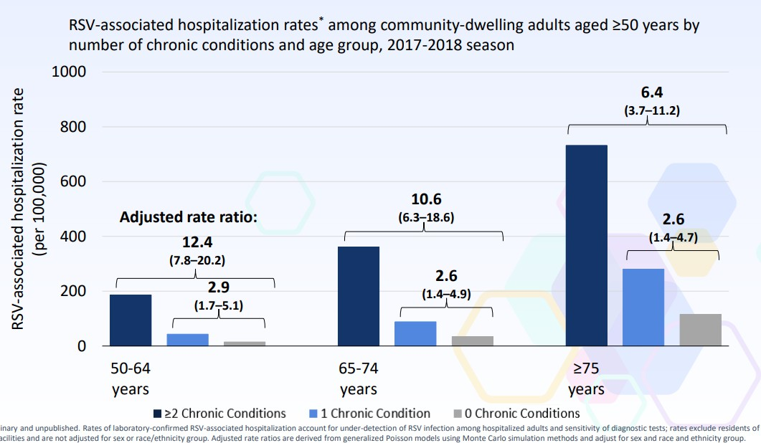
Impact of Comorbidities (*cardiac)
RSV Illness in Adults
J Alessandrini. Incidence of RSV hospitalization among adults in Ontario, Canada, 2017-2019. Presented at Canadian Immunization Conference, Nov 2024.

Slide 36

When should people get their shots?
PCV20
Only one dose, for those who have not previously received pneumo protection
Can be administered any time in the year to eligible individuals
COVID-19
Virus circulates all year
Protection lasts approximately four months, slightly longer against severe outcomes
Choose dose timing based on personal considerations
Influenza
Before the start of the influenza season (~Nov-April)
RSV products
RSV vaccines work best during the season: Nov-Apr’
Only one dose recommended
Vaccine for Seniors, comorbidities (cardiac)
Vaccine in Pregnancy 32-36 weeks gestation
Monoclonal antibodies for newborns
Thank you for immunizing/recommending vaccines

Slide 37
Where can people get immunized?
Local public health units (6 mo – 11 yo, special populations)
Community pharmacies 2 yo + flumist, 4yo+ IM influenza, 12yo+ COVID-19
  Public health units or clinics in select communities (e.g., Sooke, Saltspring Island, remote communities)
Longterm care and assisted living – on site clinics
Clinics at some acute care sites (ISLH staff)
Homebound clients:
  Community Health Services (Home Support, Home Care Nursing, etc.) contact your office to discuss if a homebound immunization is appropriate
  Community Access Line if not receiving home services but assistance is needed
Non-BC residents cannot be immunized at pharmacies (need PHN), can call provincial call centre 1-833-838-2323

Slide 38
Community Vaccine Provider Responsibilities:
Follow BCCDC Immunization Manual guidelines
Maintain cold chain and report any cold chain incidents to the local health unit*
All vaccines administered to individuals less than 19 must be reported to your local health unit when the vaccine is not documented into the Provincial Immunization Registry (i.e. Panorama, Pharmanet, ImmsBC or eForm) at time of administration
Report adverse events following immunization to the local health unit
*For more information see the Island Health website: https://www.islandhealth.ca/learn-about-health/immunizations/immunization-information-healthcare-professionals

Slide 39
Selected resources for healthcare providers:
BCCDC Influenza vaccine eligibility criteria: https://www.bccdc.ca/resource-gallery/Documents/Guidelines%20and%20Forms/Guidelines%20and%20Manuals/Epid/CD%20Manual/Chapter%202%20-%20Imms/Part4/Influenza_Eligibility.pdf
BCCDC Covid-19 vaccine eligibility criteria: https://www.bccdc.ca/resource-gallery/Documents/Guidelines%20and%20Forms/Guidelines%20and%20Manuals/Epid/CD%20Manual/Chapter%202%20-%20Imms/Part4/COVID-19-vaccine-eligibility.pdf
VCH quick reference for publicly funded seasonal influenza vaccines https://www.vch.ca/en/media/22941
BCCDC quick reference guide for adult immunization: https://www.bccdc.ca/resource-gallery/Documents/Guidelines%20and%20Forms/Guidelines%20and%20Manuals/Immunization/Vaccine%20Info/Vaccines-Recommended-Adults.pdf
Island Health information for community vaccine providers: https://www.islandhealth.ca/learn-about-health/immunizations/immunization-information-healthcare-professionals

Slide 40
Selected resources for patients:
HealthLinkBC: https://www.healthlinkbc.ca/
  Covid-19 mRNA vaccines
  Influenza vaccine
  Influenza (flu) immunization: myths and facts
  Pneumococcal vaccine
  RSV vaccine
  HPV vaccine
  Vaccine side effects
  The immunization visit
  Immunization in your baby’s first year
  Immunization and pregnancy
  A better immunization experience for your child
  …and many more!

Slide 41



Slide 42
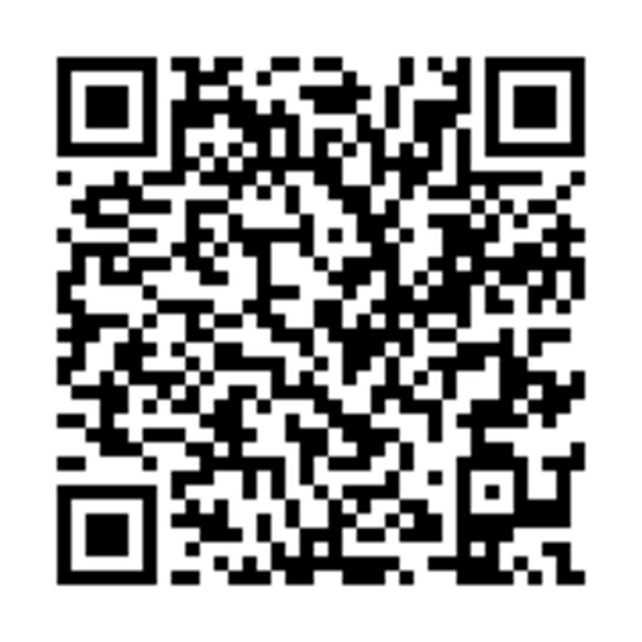
Thank you!
Please complete our Feedback Survey: https://surveys.islandhealth.ca/surveys/Public-Health-Grand-Rounds-Oct-2025

